Slide 1

Bachelor Thesis Presentation
Control of a Three Degree of Freedom Quadcopter Stand Using a Linear Quadratic Integral Regulator Based on the Differential Game Theory
By:
Ali BaniAsad
Supervisor:
Dr.Hadi Nobahari

Slide 2
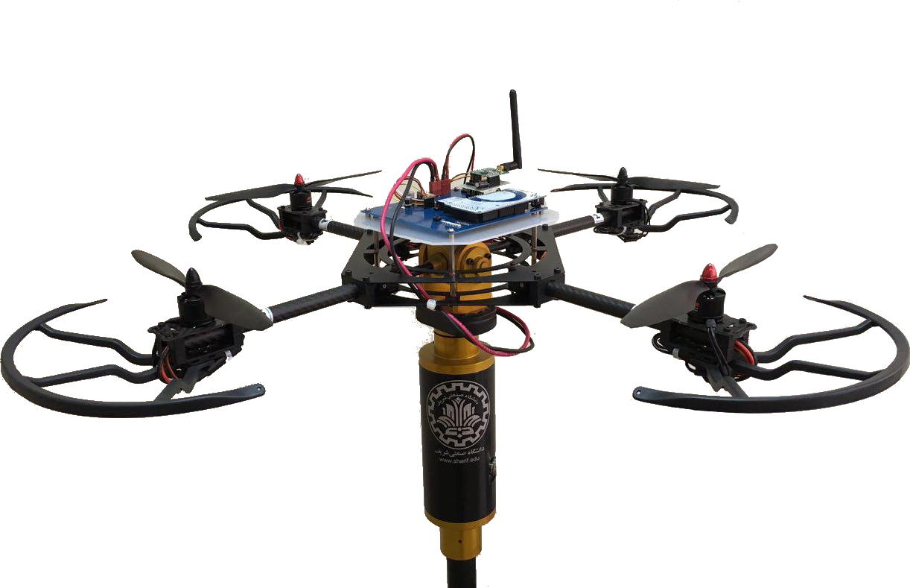
Quadcopter
Three Degree of Freedom Quadcopter Stand

Slide 3
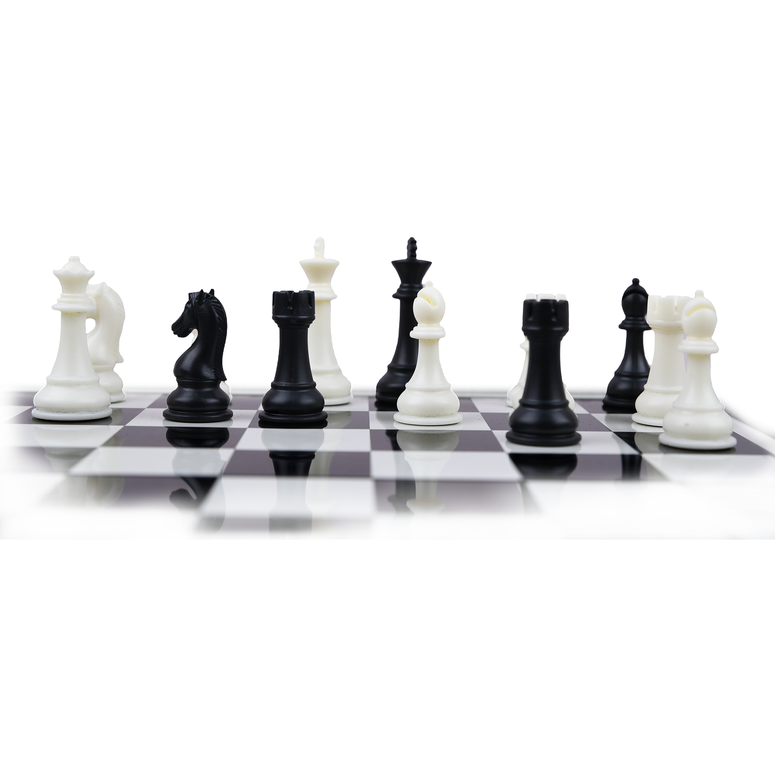
Game Theory
John Forbes Nash Jr.

Slide 4
LQDG Controller
$$\begin{matrix} & \overset{·}{x}(t)=Ax(t)+B_{1}u_{1}(t)+B_{2}u_{2}(t) \\ & y(t)=Cx(t)+D_{1}u_{1}(t)+D_{2}u_{2}(t)\end{matrix}$$
$$u_{i}(t)=-{R_{ii}}^{-1}{B_{i}}^{T}K_{i}(t)x(t),i=1,2$$
$$J_{i}(u_{1},u_{2})=∫_{0}^{T}\left(x^{T}(t)Q_{i}x(t)+{u_{i}}^{T}(t)R_{ii}u_{i}(t)+{u_{j}}^{T}(t)R_{ij}u_{j}(t)\right)dt$$
$$\begin{matrix}{\overset{·}{K}}_{1}(t) & =-A^{T}K_{1}(t)-K_{1}(t)A-Q_{1}+K_{1}(t)S_{1}(t)K_{1}(t)+K_{1}(t)S_{2}(t)K_{2}(t) \\ {\overset{·}{K}}_{2}(t) & =-A^{T}K_{2}(t)-K_{2}(t)A-Q_{2}+K_{2}(t)S_{2}(t)K_{2}(t)+K_{2}(t)S_{1}(t)K_{1}(t)\end{matrix}$$
$$S_{i}:={B_{i}R_{ii}}^{-1}{B_{i}}^{T}$$

Slide 5
LQIDG Controller
Augmented Space State
$$x_{a}=\left[\begin{aligned}x_{d}-x \\ ∫(y_{d}-y)\end{aligned}\right]$$
$$A_{a}=\left[\begin{matrix}A & 0 \\ C & 0\end{matrix}\right]$$
$$B_{a}=\left[\begin{aligned}B \\ 0\end{aligned}\right]$$
$$\begin{matrix} & {\overset{·}{x}}_{a}(t)=A_{a}x_{a}(t)+B_{a_{1}}u_{a_{1}}(t)+B_{a_{2}}u_{a_{2}}(t) \\ & y(t)=C_{a}x_{a}(t)+D_{a_{1}}u_{a_{1}}(t)+D_{a_{2}}u_{a_{2}}(t)\end{matrix}$$

Slide 6
LQIDG Controller
$$u_{i}(t)=-{R_{ii}}^{-1}{B_{a_{i}}}^{T}K_{a_{i}}(t)x_{a}(t),i=1,2$$
$$J_{i}(u_{1},u_{2})=∫_{0}^{T}\left({x_{a}}^{T}(t)Q_{i}x_{a}(t)+{u_{i}}^{T}(t)R_{ii}u_{i}(t)+{u_{j}}^{T}(t)R_{ij}u_{j}(t)\right)dt$$
$$\begin{matrix}{\overset{·}{K}}_{a_{1}}(t) & =-A^{T}K_{a_{1}}(t)-K_{a_{1}}(t)A-Q_{a_{1}}+K_{a_{1}}(t)S_{a_{1}}(t)K_{a_{1}}(t)+K_{a_{1}}(t)S_{a_{2}}(t)K_{a_{2}}(t) \\ {\overset{·}{K}}_{a_{2}}(t) & =-A^{T}K_{a_{2}}(t)-K_{a_{2}}(t)A-Q_{a_{2}}+K_{a_{2}}(t)S_{a_{2}}(t)K_{a_{2}}(t)+K_{a_{2}}(t)S_{a_{1}}(t)K_{a_{1}}(t)\end{matrix}$$
$$S_{a_{i}}:={B_{a_{i}}R_{ii}}^{-1}{B_{a_{i}}}^{T}$$

Slide 7
Mathematical Model
$$f=\left[\begin{aligned}x_{4}+x_{5}sin(x_{1})tan(x_{2})+x_{6}cos(x_{1})tan(x_{2}) \\ x_{5}cos(x_{1})-x_{6}sin(x_{1}) \\ (x_{5}sin(x_{1})+x_{6}cos(x_{1}))sec(x_{2}) \\ A_{1}cos(x_{2})sin(x_{1})+A_{2}x_{5}x_{6}+A_{3}σ_{1}+A_{4}x_{5}σ_{4}-\frac{x_{4}}{|x_{4}|}A_{5}+A_{6}cos(x_{1}) \\ B_{1}sin(x_{2})+B_{2}x_{4}x_{6}+B_{3}σ_{2}+B_{4}x_{4}σ_{4}-\frac{x_{5}}{|x_{5}|}B_{5}+B_{6}cos(x_{2}) \\ C_{1}x_{4}x_{5}+C_{2}σ_{3}-\frac{x_{6}}{|x_{6}|}C_{3}\end{aligned}\right]$$
$$σ_{1}=ω_{2}^{2}-ω_{4}^{2},σ_{2}=ω_{1}^{2}-ω_{3}^{2},σ_{3}=ω_{1}^{2}-ω_{2}^{2}+ω_{3}^{2}-ω_{4}^{2},σ_{4}=ω_{1}-ω_{2}+ω_{3}-ω_{4}$$

Slide 8
Mathematical Model
$$\begin{matrix} & A_{1}=\frac{h_{cg}gm_{tot}}{m_{tot}h_{cg}^{2}+J_{11}} & & A_{2}=\frac{2m_{tot}h_{cg}^{2}+J_{22}-J_{33}}{m_{tot}h_{cg}^{2}+J_{11}} & & A_{3}=\frac{bd_{cg}}{m_{tot}h_{cg}^{2}+J_{11}} & \\ & A_{4}=\frac{J_{R}}{m_{tot}h_{cg}^{2}+J_{11}} & & A_{5}=\frac{m_{1}gμr_{x}}{m_{tot}h_{cg}^{2}+J_{11}} & & A_{6}=\frac{m_{tot}x_{cg}}{m_{tot}h_{cg}^{2}+J_{11}} & \\ & B_{1}=\frac{h_{cg}gm_{tot}}{m_{tot}h_{cg}^{2}+J_{22}} & & B_{2}=\frac{-2m_{tot}h_{cg}^{2}-J_{11}+J_{33}}{m_{tot}h_{cg}^{2}+J_{22}} & & B_{3}=\frac{bd_{cg}}{m_{tot}h_{cg}^{2}+J_{22}} & \\ & B_{4}=\frac{-J_{R}}{m_{tot}h_{cg}^{2}+J_{22}} & & B_{5}=\frac{m_{2}gμr_{y}}{m_{tot}h_{cg}^{2}+J_{22}} & & B_{6}=\frac{m_{tot}y_{cg}}{m_{tot}h_{cg}^{2}+J_{22}} & \end{matrix}$$
$$\begin{aligned}C_{1}=\frac{J_{11}-J_{22}}{J_{33}}C_{2}=\frac{d}{J_{33}}C_{3}=\frac{m_{3}gμr_{z}}{J_{33}}\end{aligned}$$

Slide 9
Roll Space State
$$A_{roll}=\left[\begin{matrix}\frac{∂f_{1}}{∂x_{1}} & \frac{∂f_{1}}{∂x_{4}} \\ \frac{∂f_{4}}{∂x_{1}} & \frac{∂f_{4}}{∂x_{4}}\end{matrix}\right]=\left[\begin{matrix}0 & 1 \\ A_{1}cos(x_{1}) & 0\end{matrix}\right]$$
$$B_{roll}=\left[\begin{aligned}\frac{∂f_{1}}{∂u_{1}} \\ \frac{∂f_{4}}{∂u_{1}}\end{aligned}\right]=\left[\begin{aligned}0 \\ A_{3}\end{aligned}\right]$$

Slide 10
Pitch Space State
$$A_{pitch}=\left[\begin{matrix}\frac{∂f_{2}}{∂x_{2}} & \frac{∂f_{2}}{∂x_{5}} \\ \frac{∂f_{5}}{∂x_{2}} & \frac{∂f_{5}}{∂x_{5}}\end{matrix}\right]=\left[\begin{matrix}0 & 1 \\ B_{1}cos(x_{1}) & 0\end{matrix}\right]$$
$$B_{pitch}=\left[\begin{aligned}\frac{∂f_{2}}{∂u_{2}} \\ \frac{∂f_{5}}{∂u_{2}}\end{aligned}\right]=\left[\begin{aligned}0 \\ B_{3}\end{aligned}\right]$$

Slide 11
Yaw Space State
$$A_{yaw}=\left[\begin{matrix}\frac{∂f_{3}}{∂x_{3}} & \frac{∂f_{3}}{∂x_{6}} \\ \frac{∂f_{6}}{∂x_{3}} & \frac{∂f_{6}}{∂x_{6}}\end{matrix}\right]=\left[\begin{matrix}0 & 1 \\ 0 & 0\end{matrix}\right]$$
$$B_{yaw}=\left[\begin{aligned}\frac{∂f_{3}}{∂u_{3}} \\ \frac{∂f_{6}}{∂u_{3}}\end{aligned}\right]=\left[\begin{aligned}0 \\ C_{2}\end{aligned}\right]$$

Slide 12
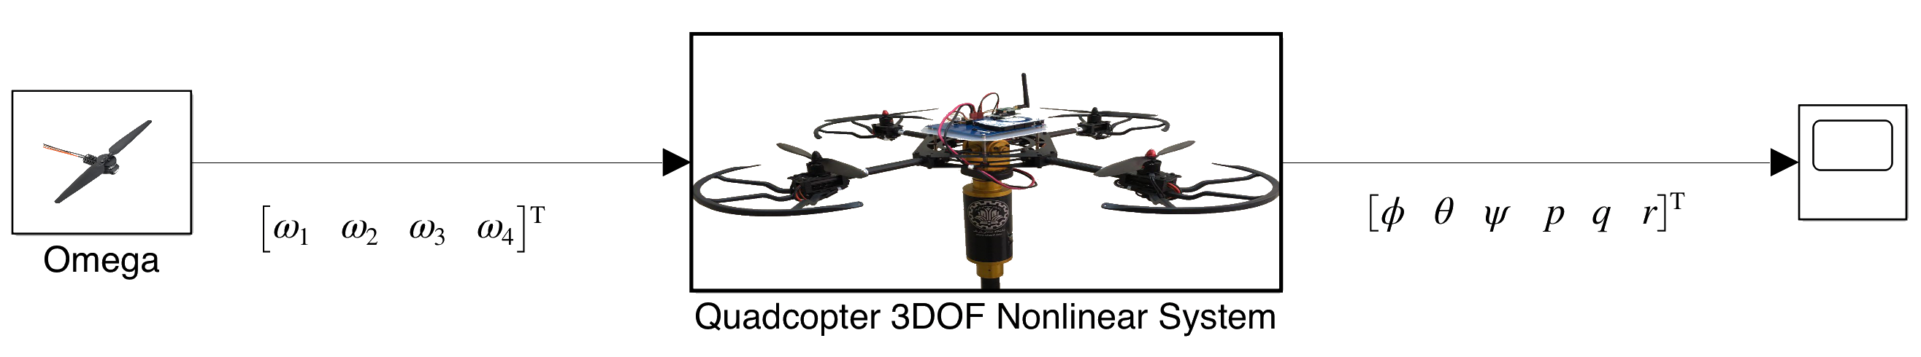
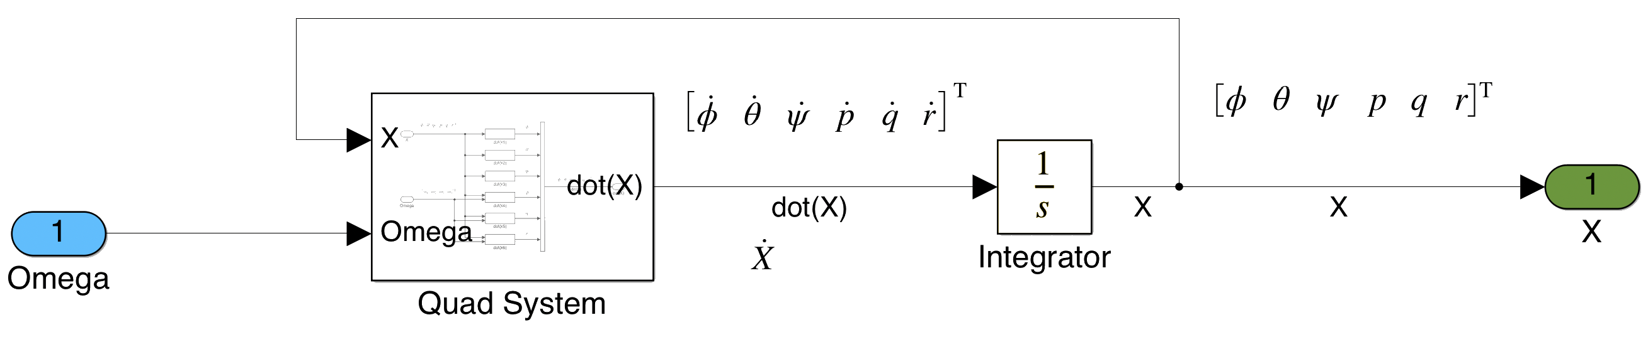
Simulation
Stand Simulation in MATLAB Simulink

Slide 13
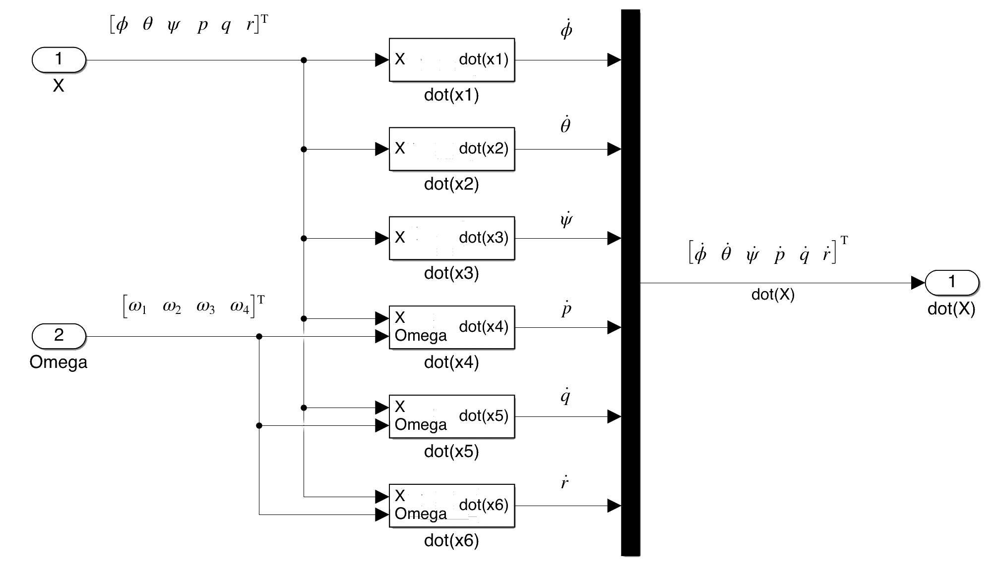
Simulation

Slide 14
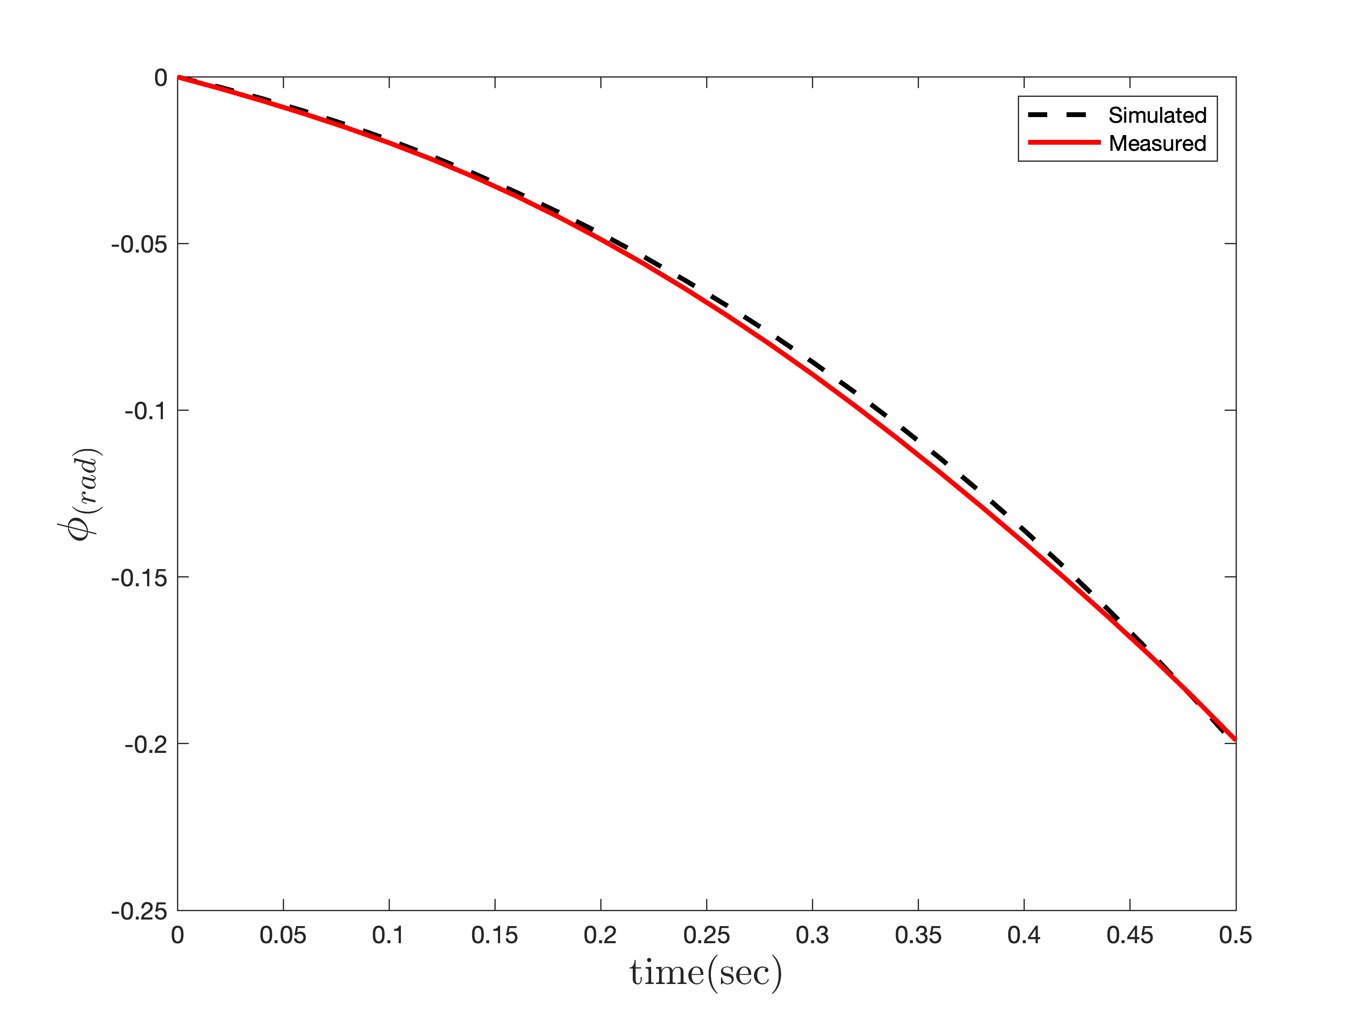
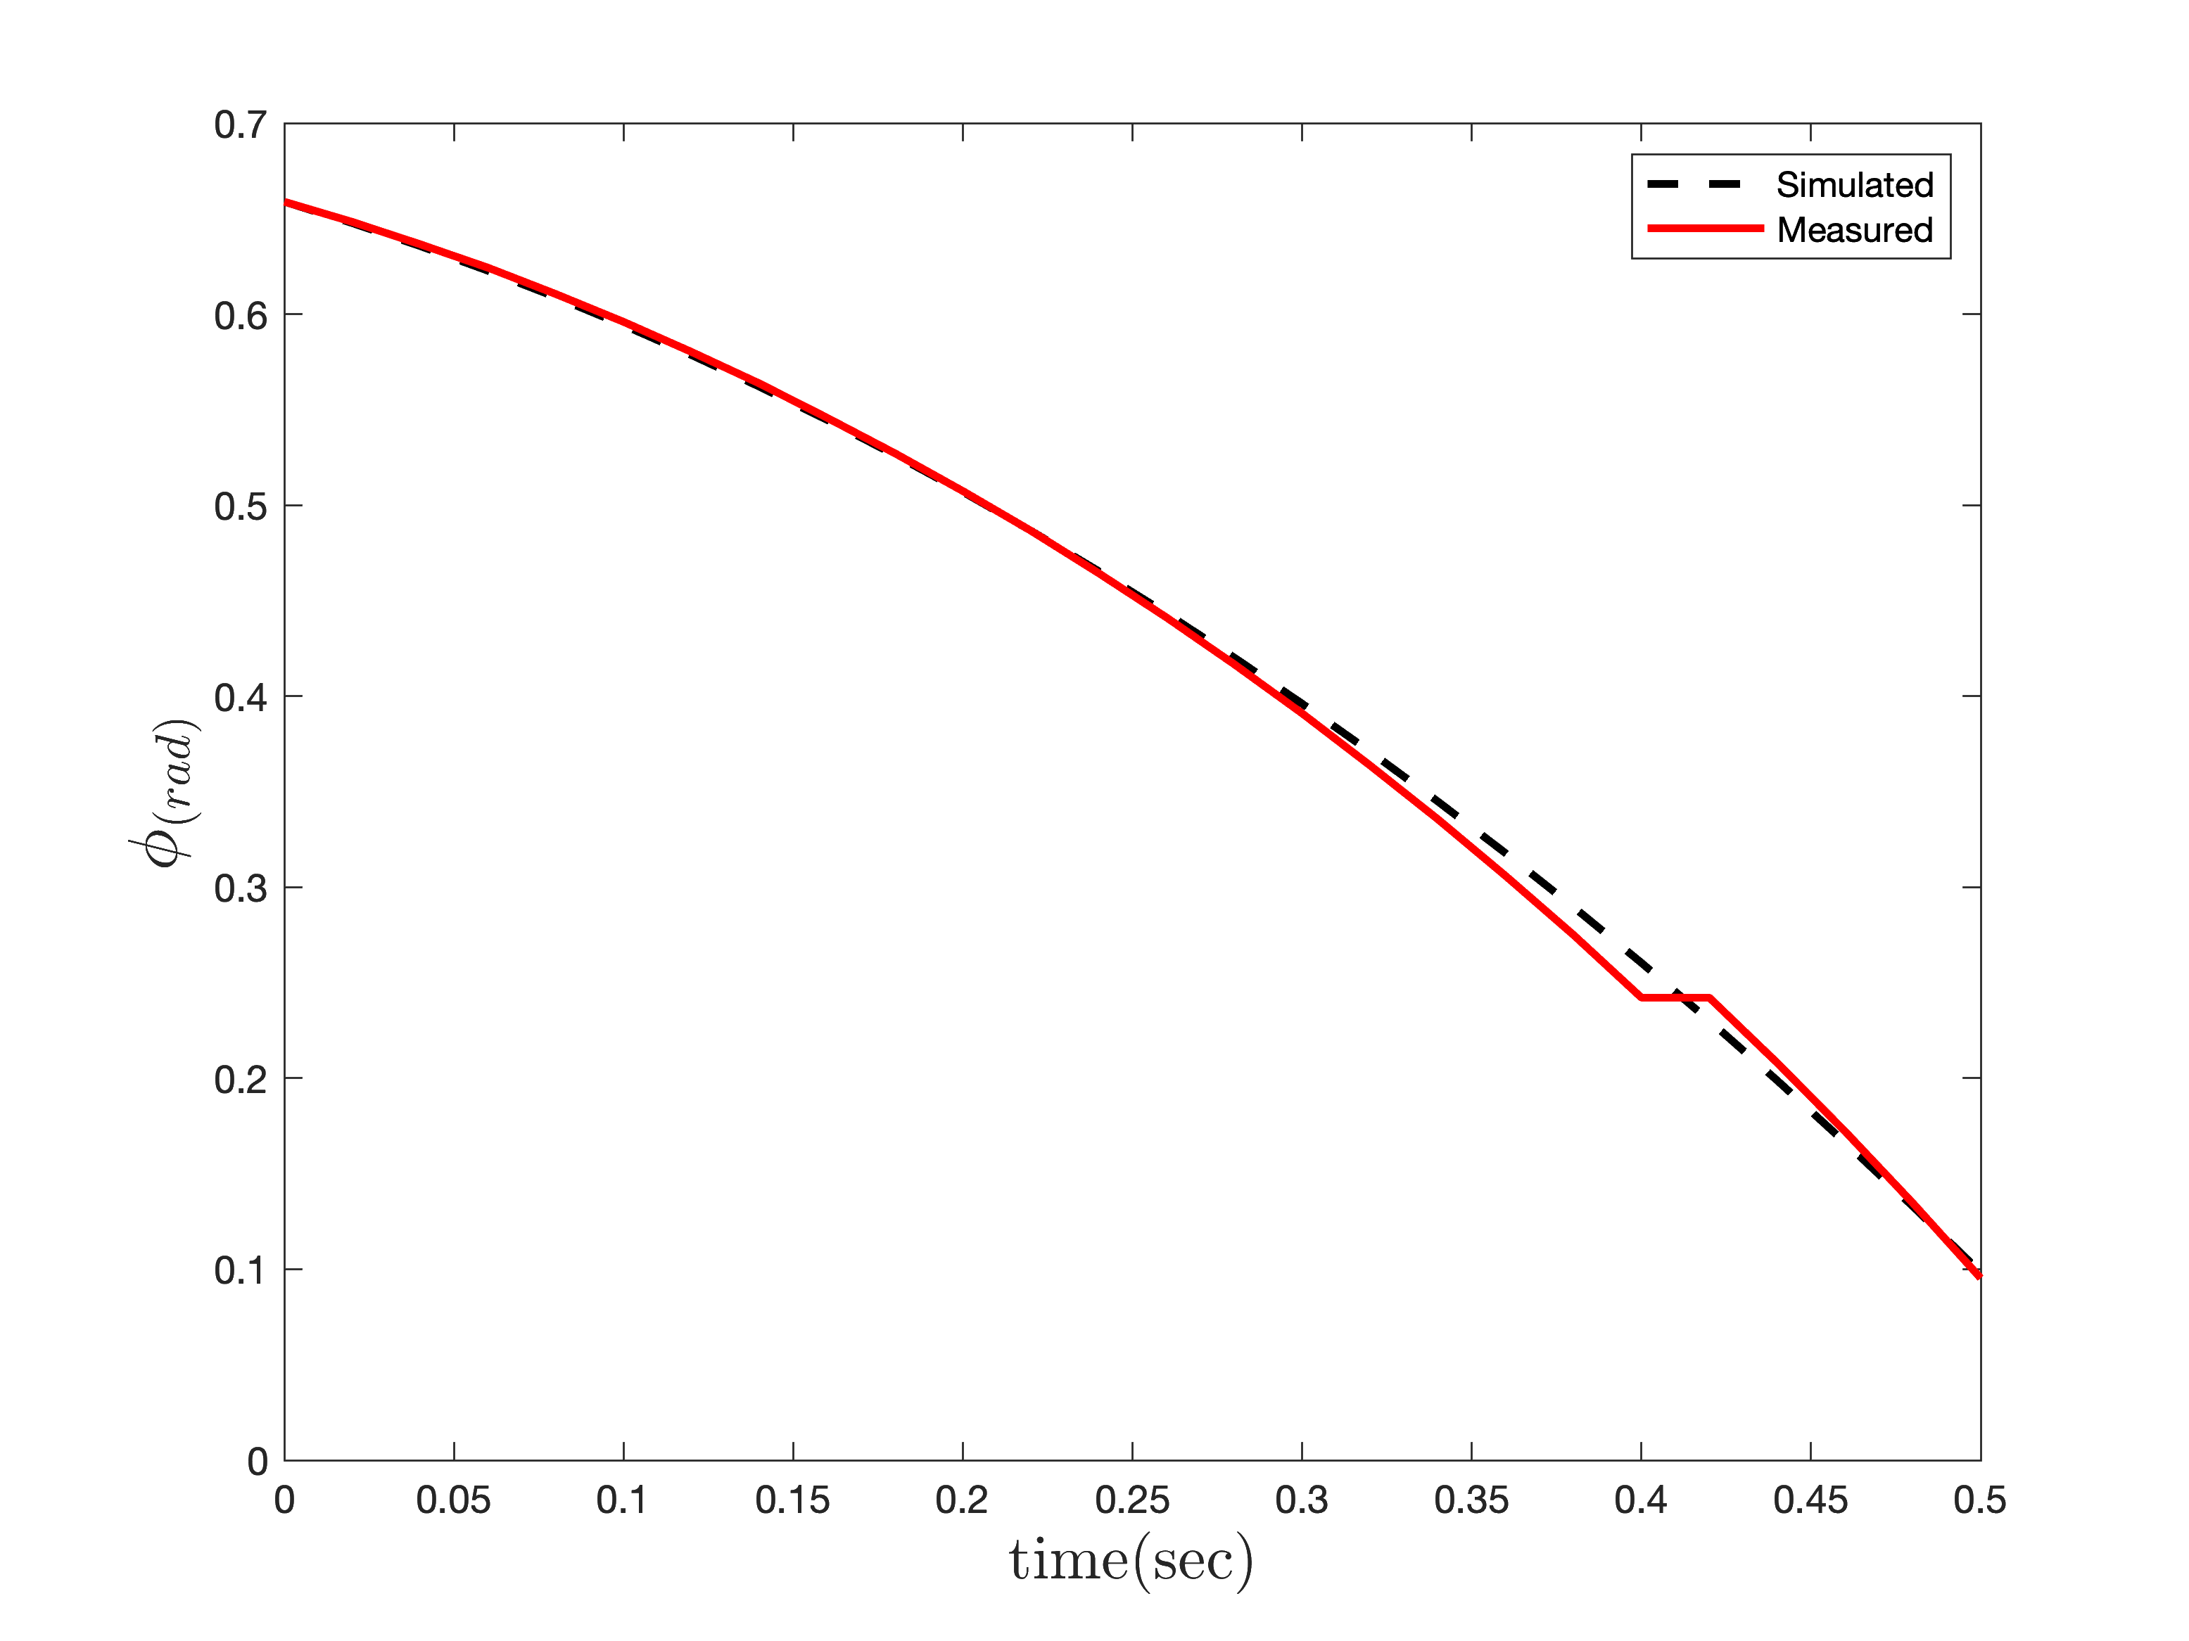
Simulation
Parameter Estimation
Roll
Without Motor
With Motor

Slide 15
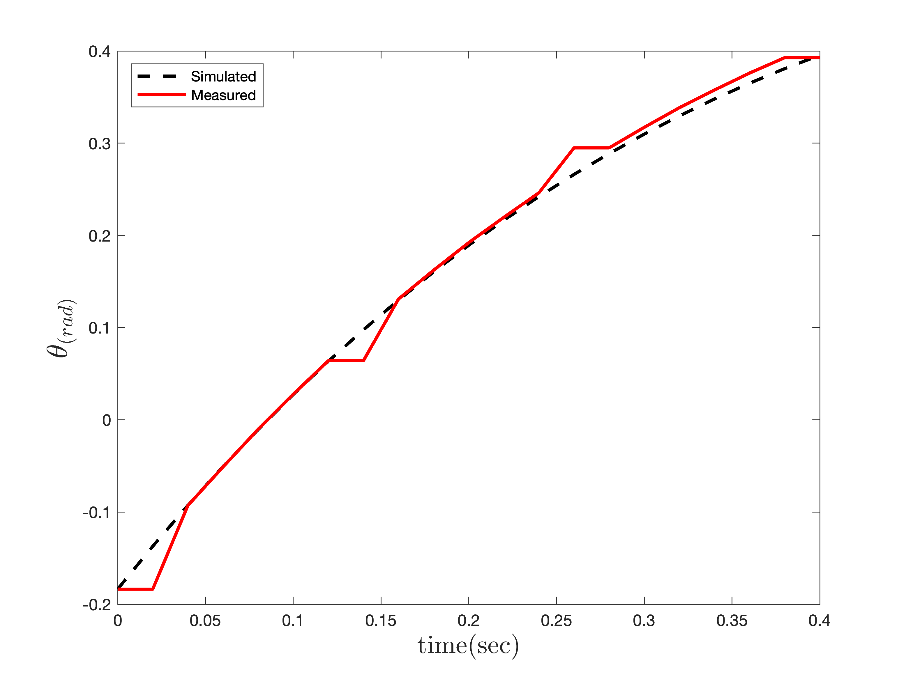
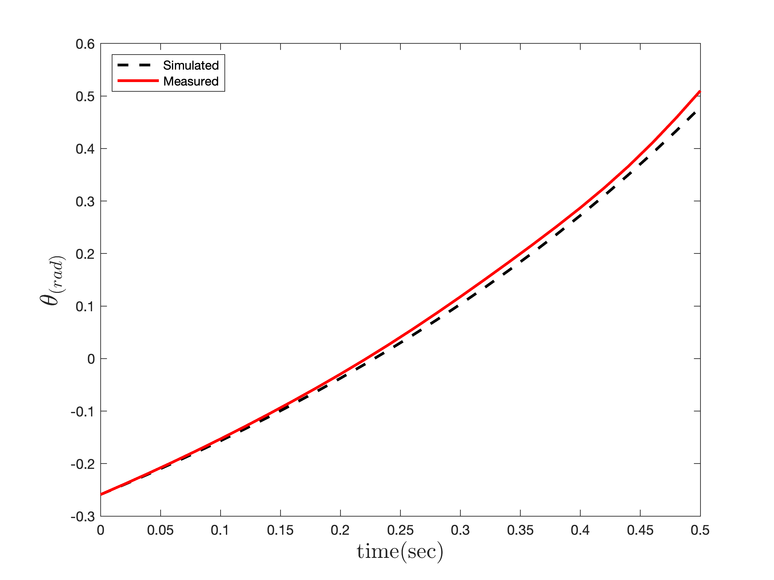
Simulation
Parameter Estimation
Pitch
Without Motor
With Motor

Slide 16
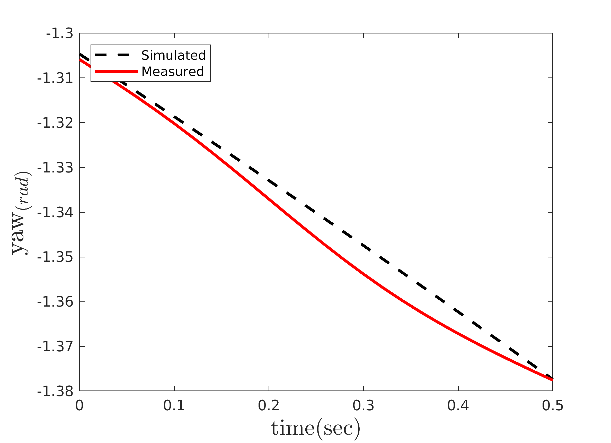
Simulation
Parameter Estimation
Yaw

Slide 17
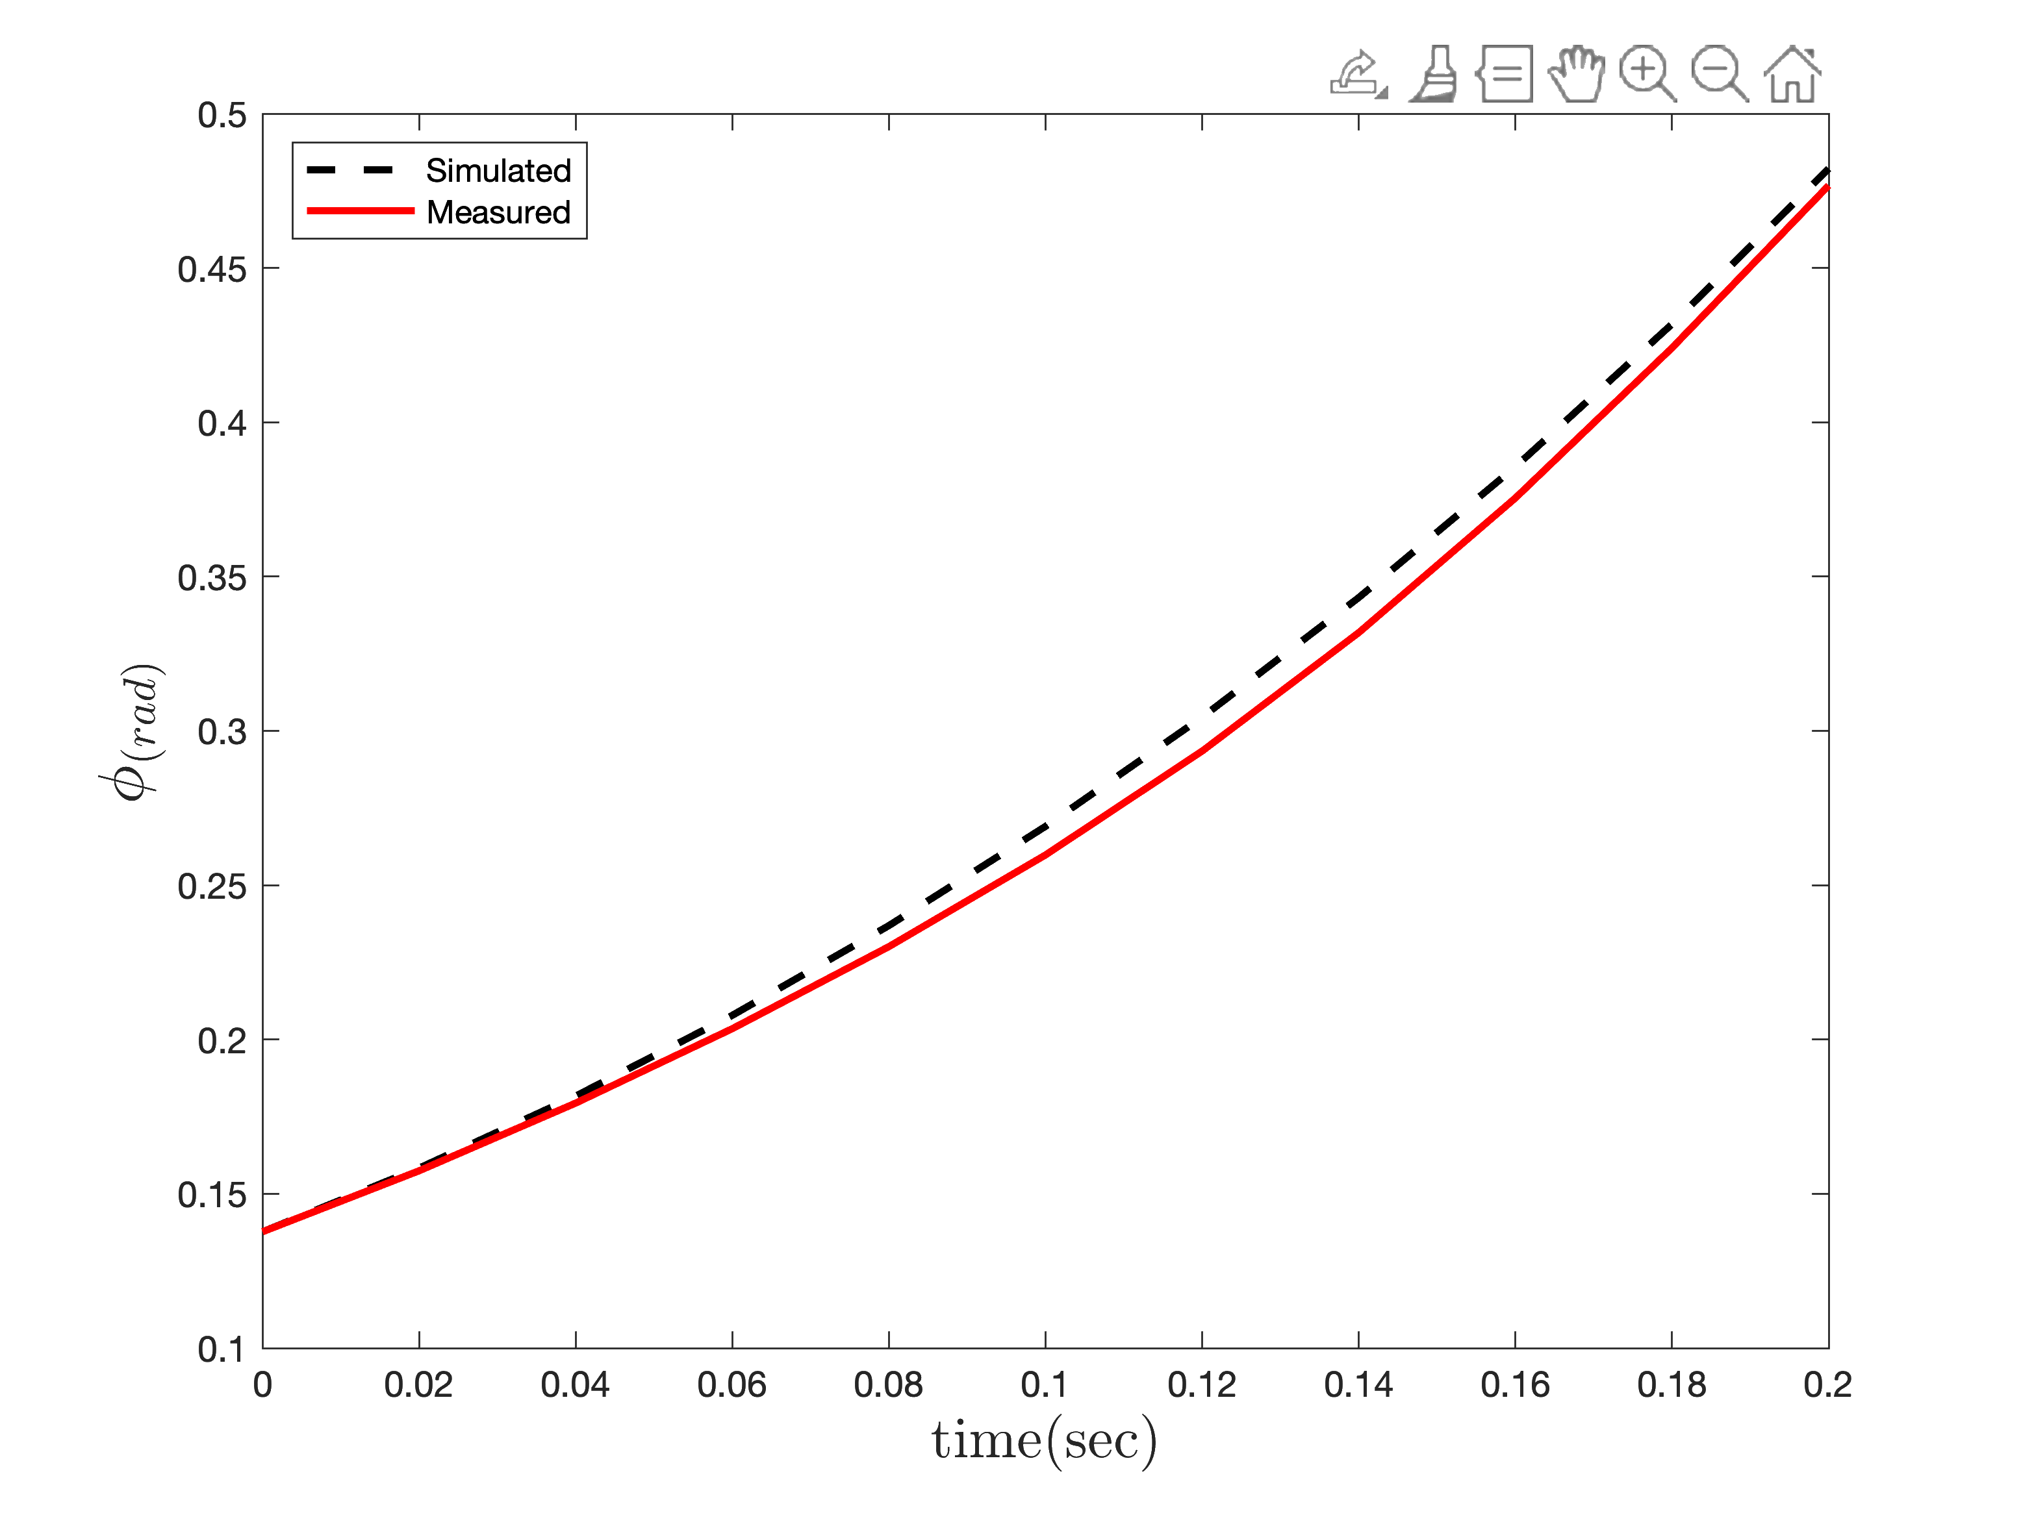
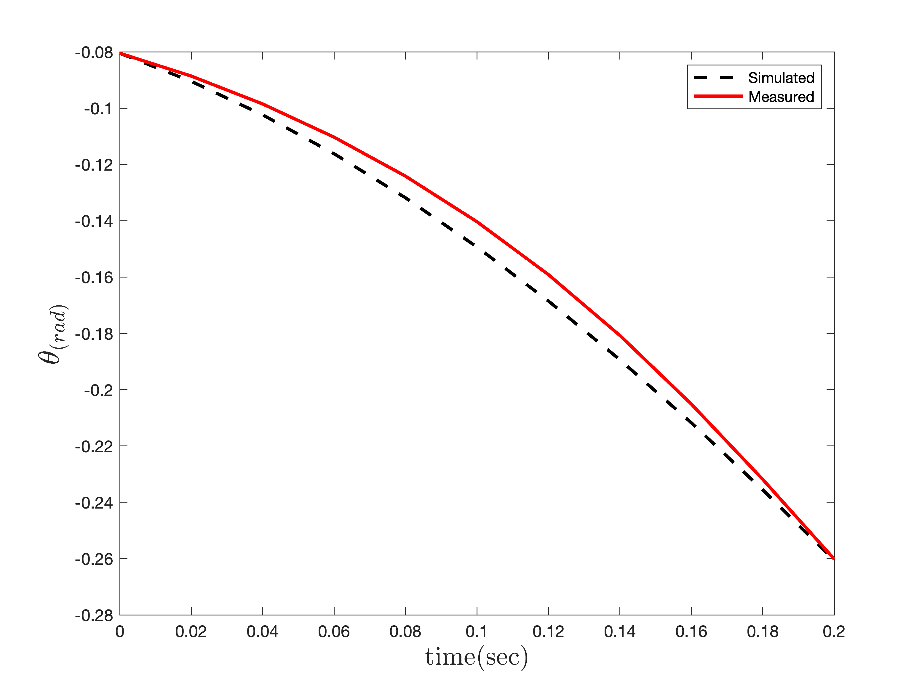
Simulation
Parameter Estimation
Roll-Pitch

Slide 18
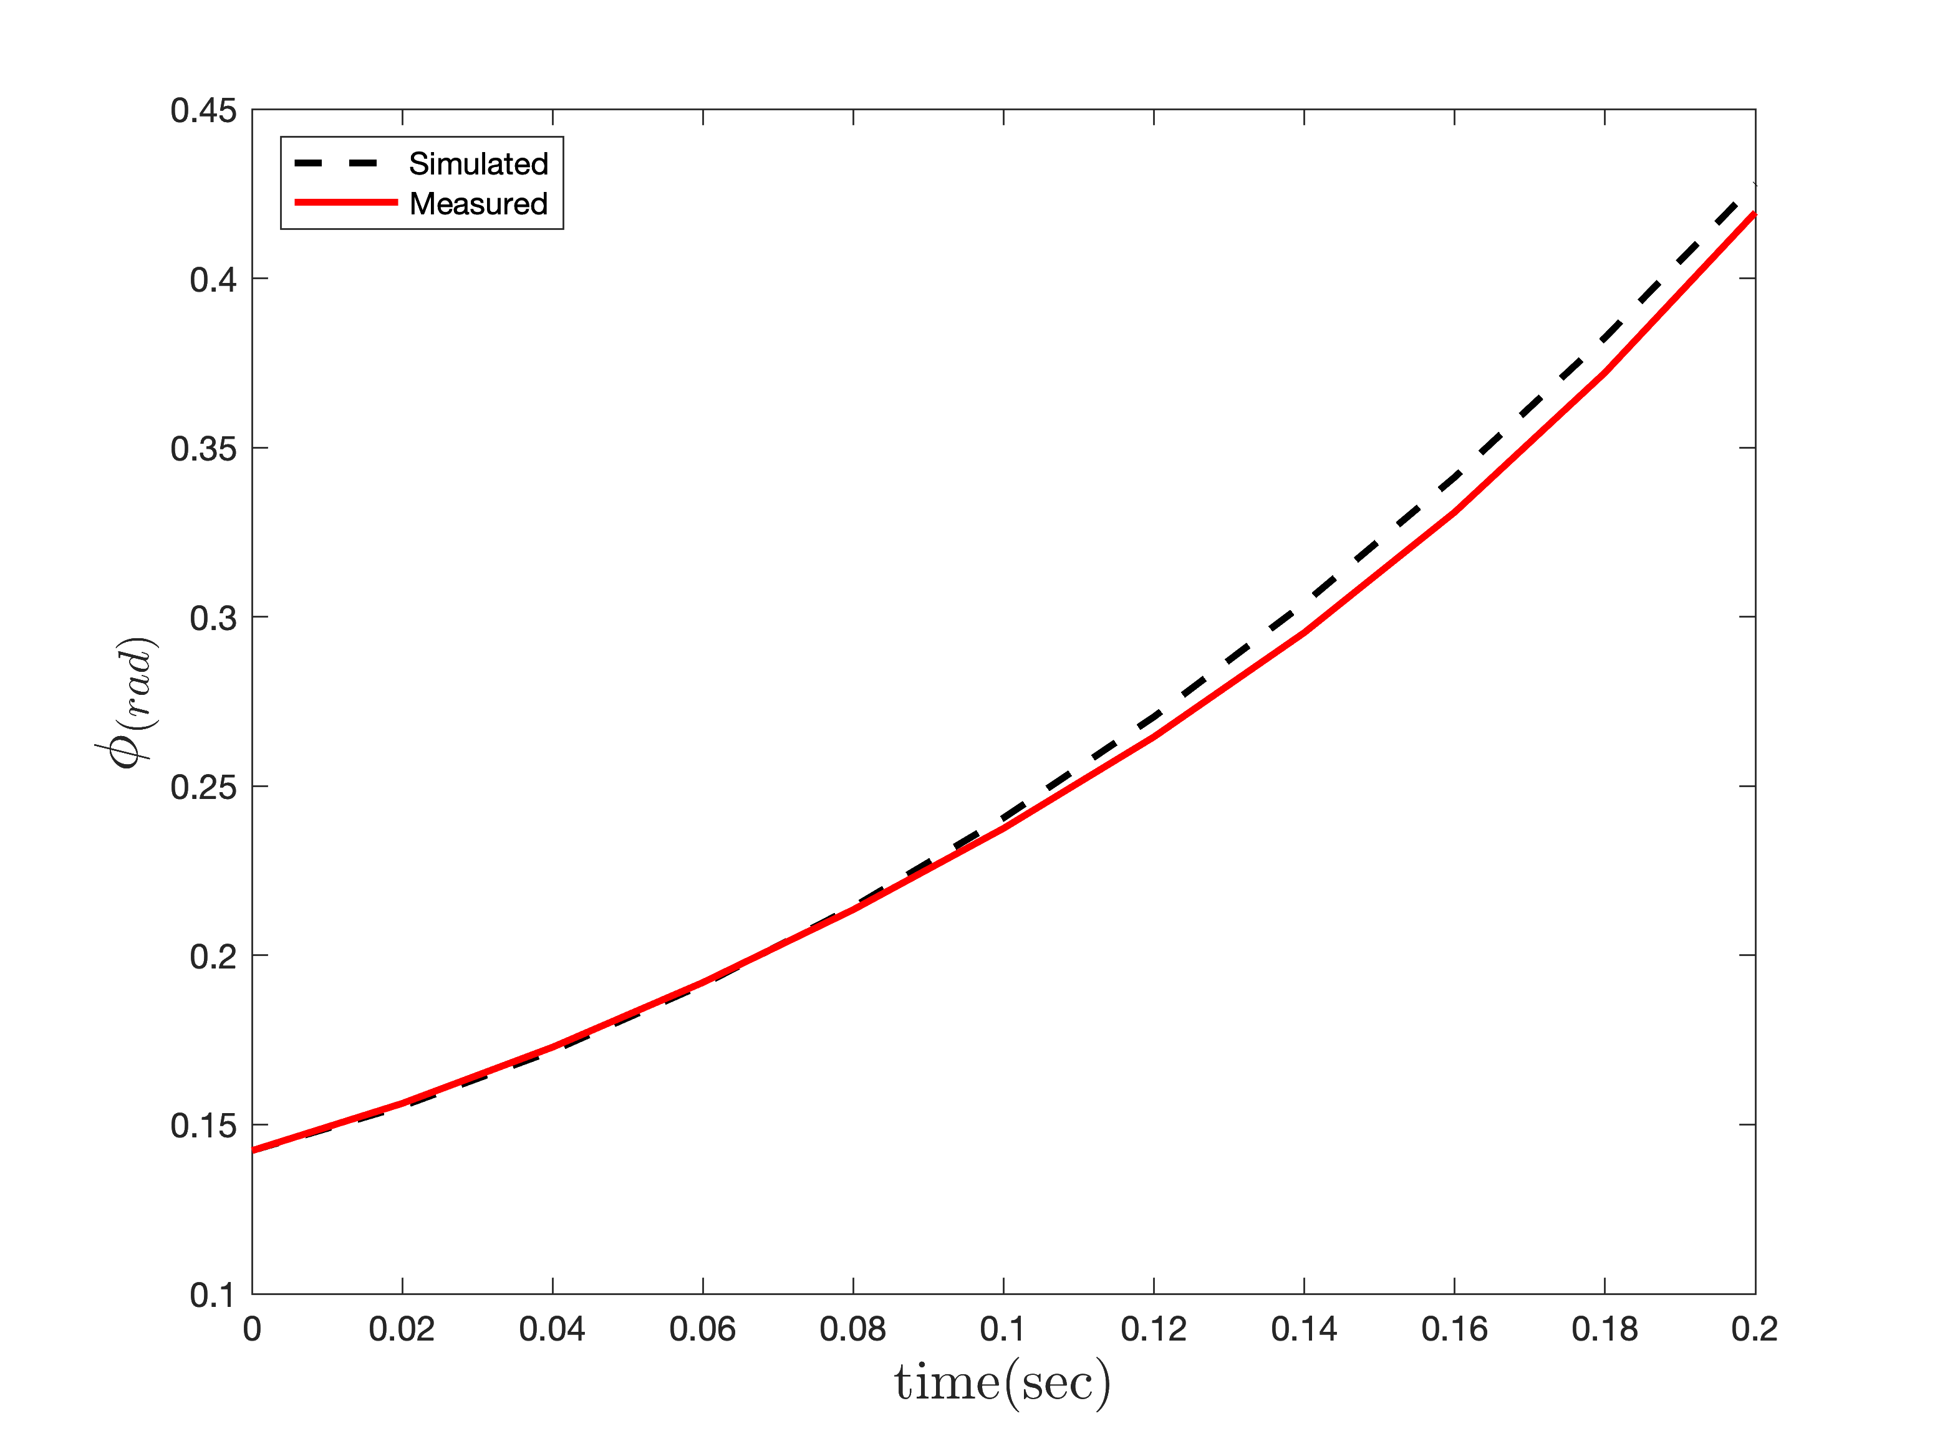
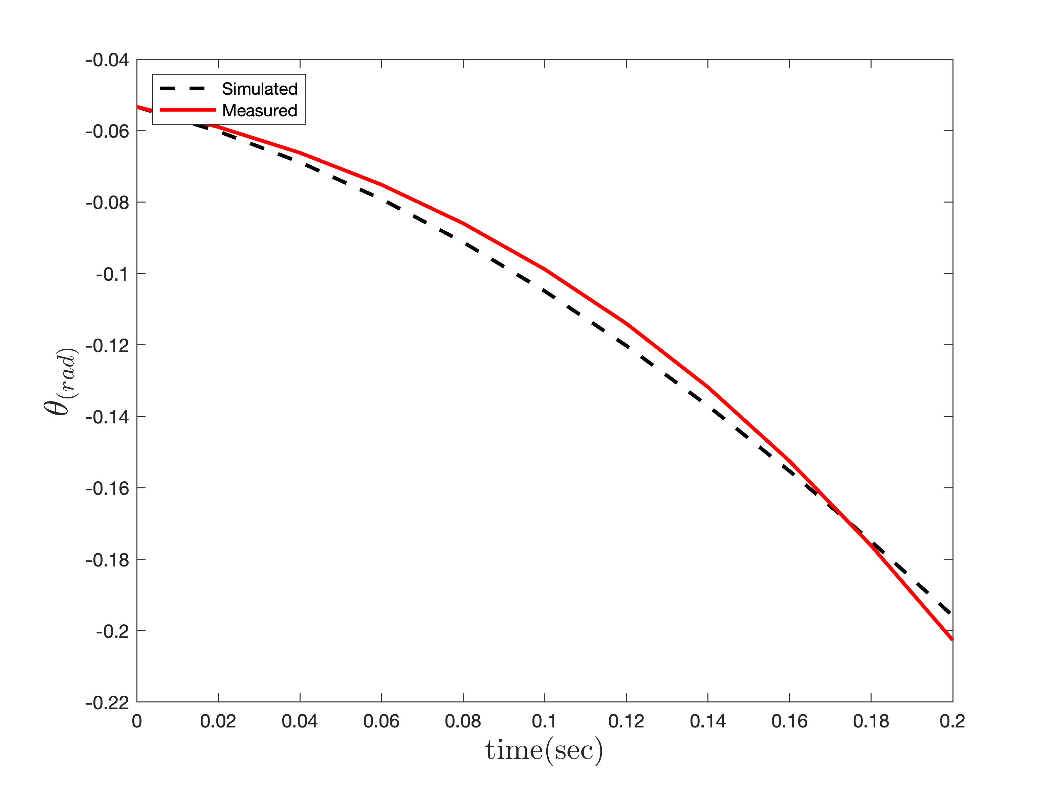
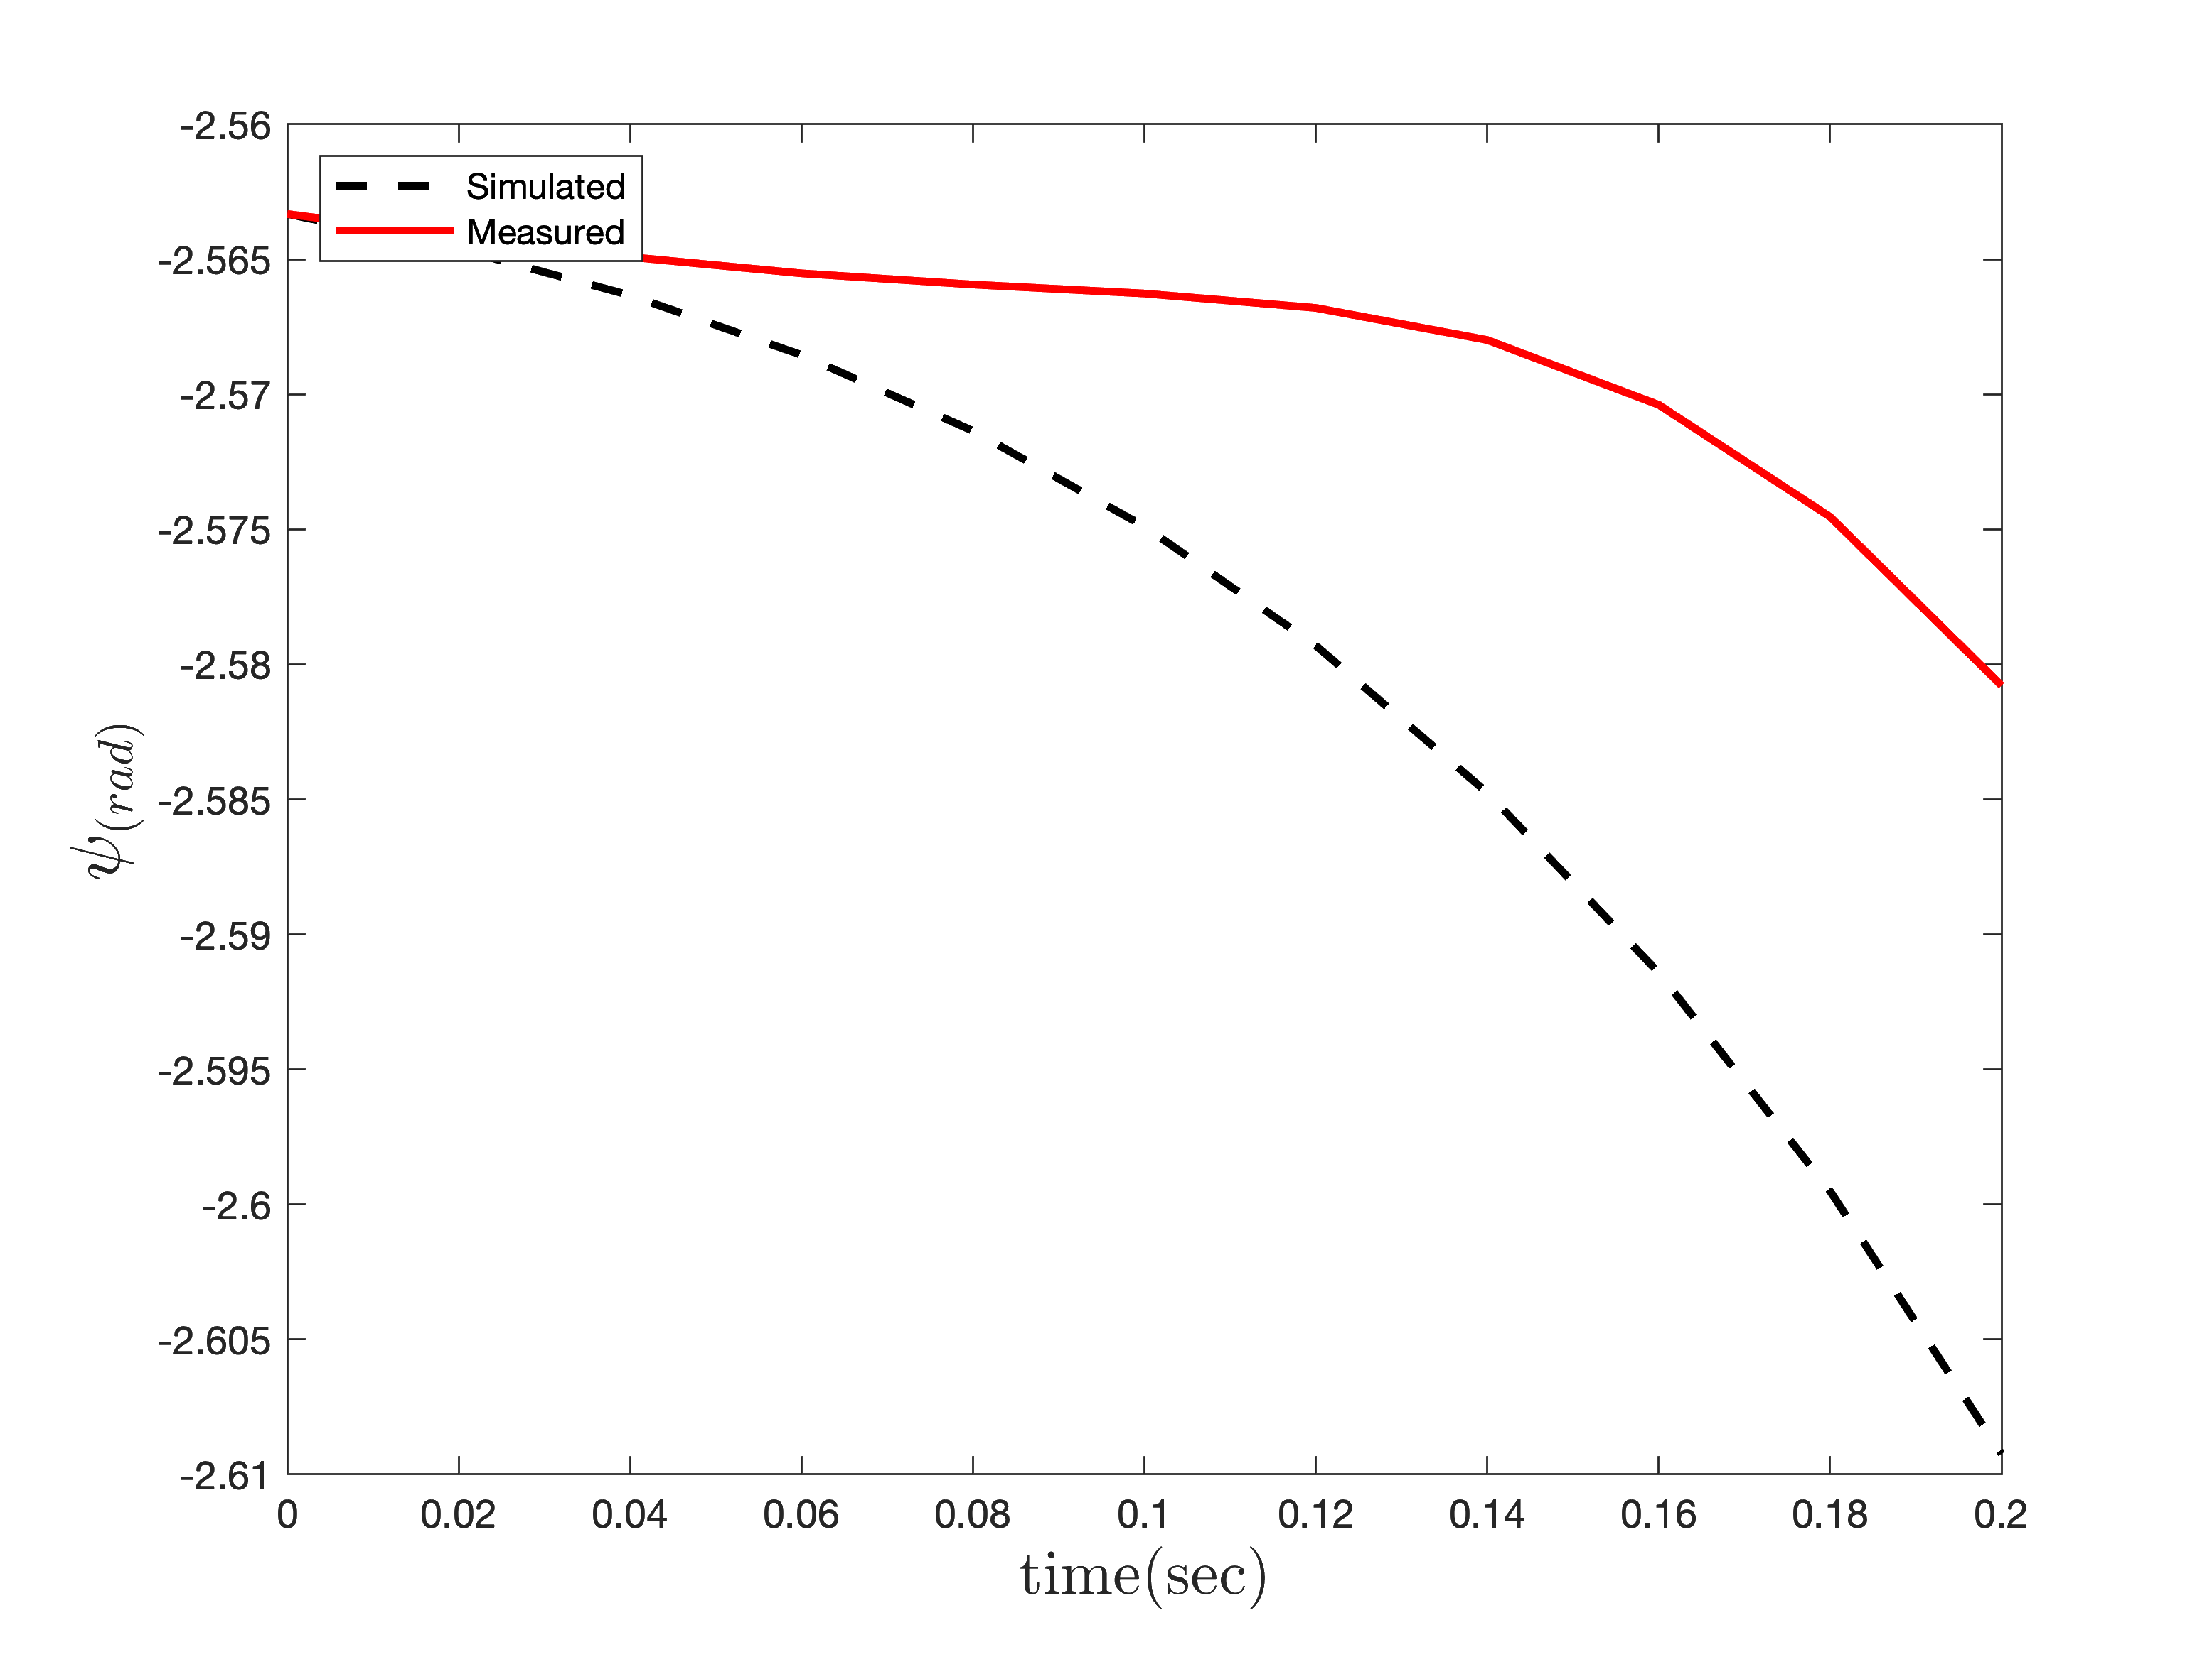
Simulation
Parameter Estimation
3 Degree Of Freedom

Slide 19
Controller Design
LQR
$$\overset{·}{x}(t)=Ax(t)+Bu(t)$$
$$u_{i}(t)=-K_{LQR}x(t)$$
$$J(u)=∫_{0}^{T}\left(x^{T}(t)Qx(t)+u^{T}(t)Ru(t)\right)dt$$
$$K_{LQR}=R^{-1}B^{T}P$$
$$\overset{·}{P}(t)=A^{T}P(t)+P(t)A-P(t)BR^{-1}B^{T}P(t)+Q$$
Weighting matrices optimized using TCACS.

Slide 20
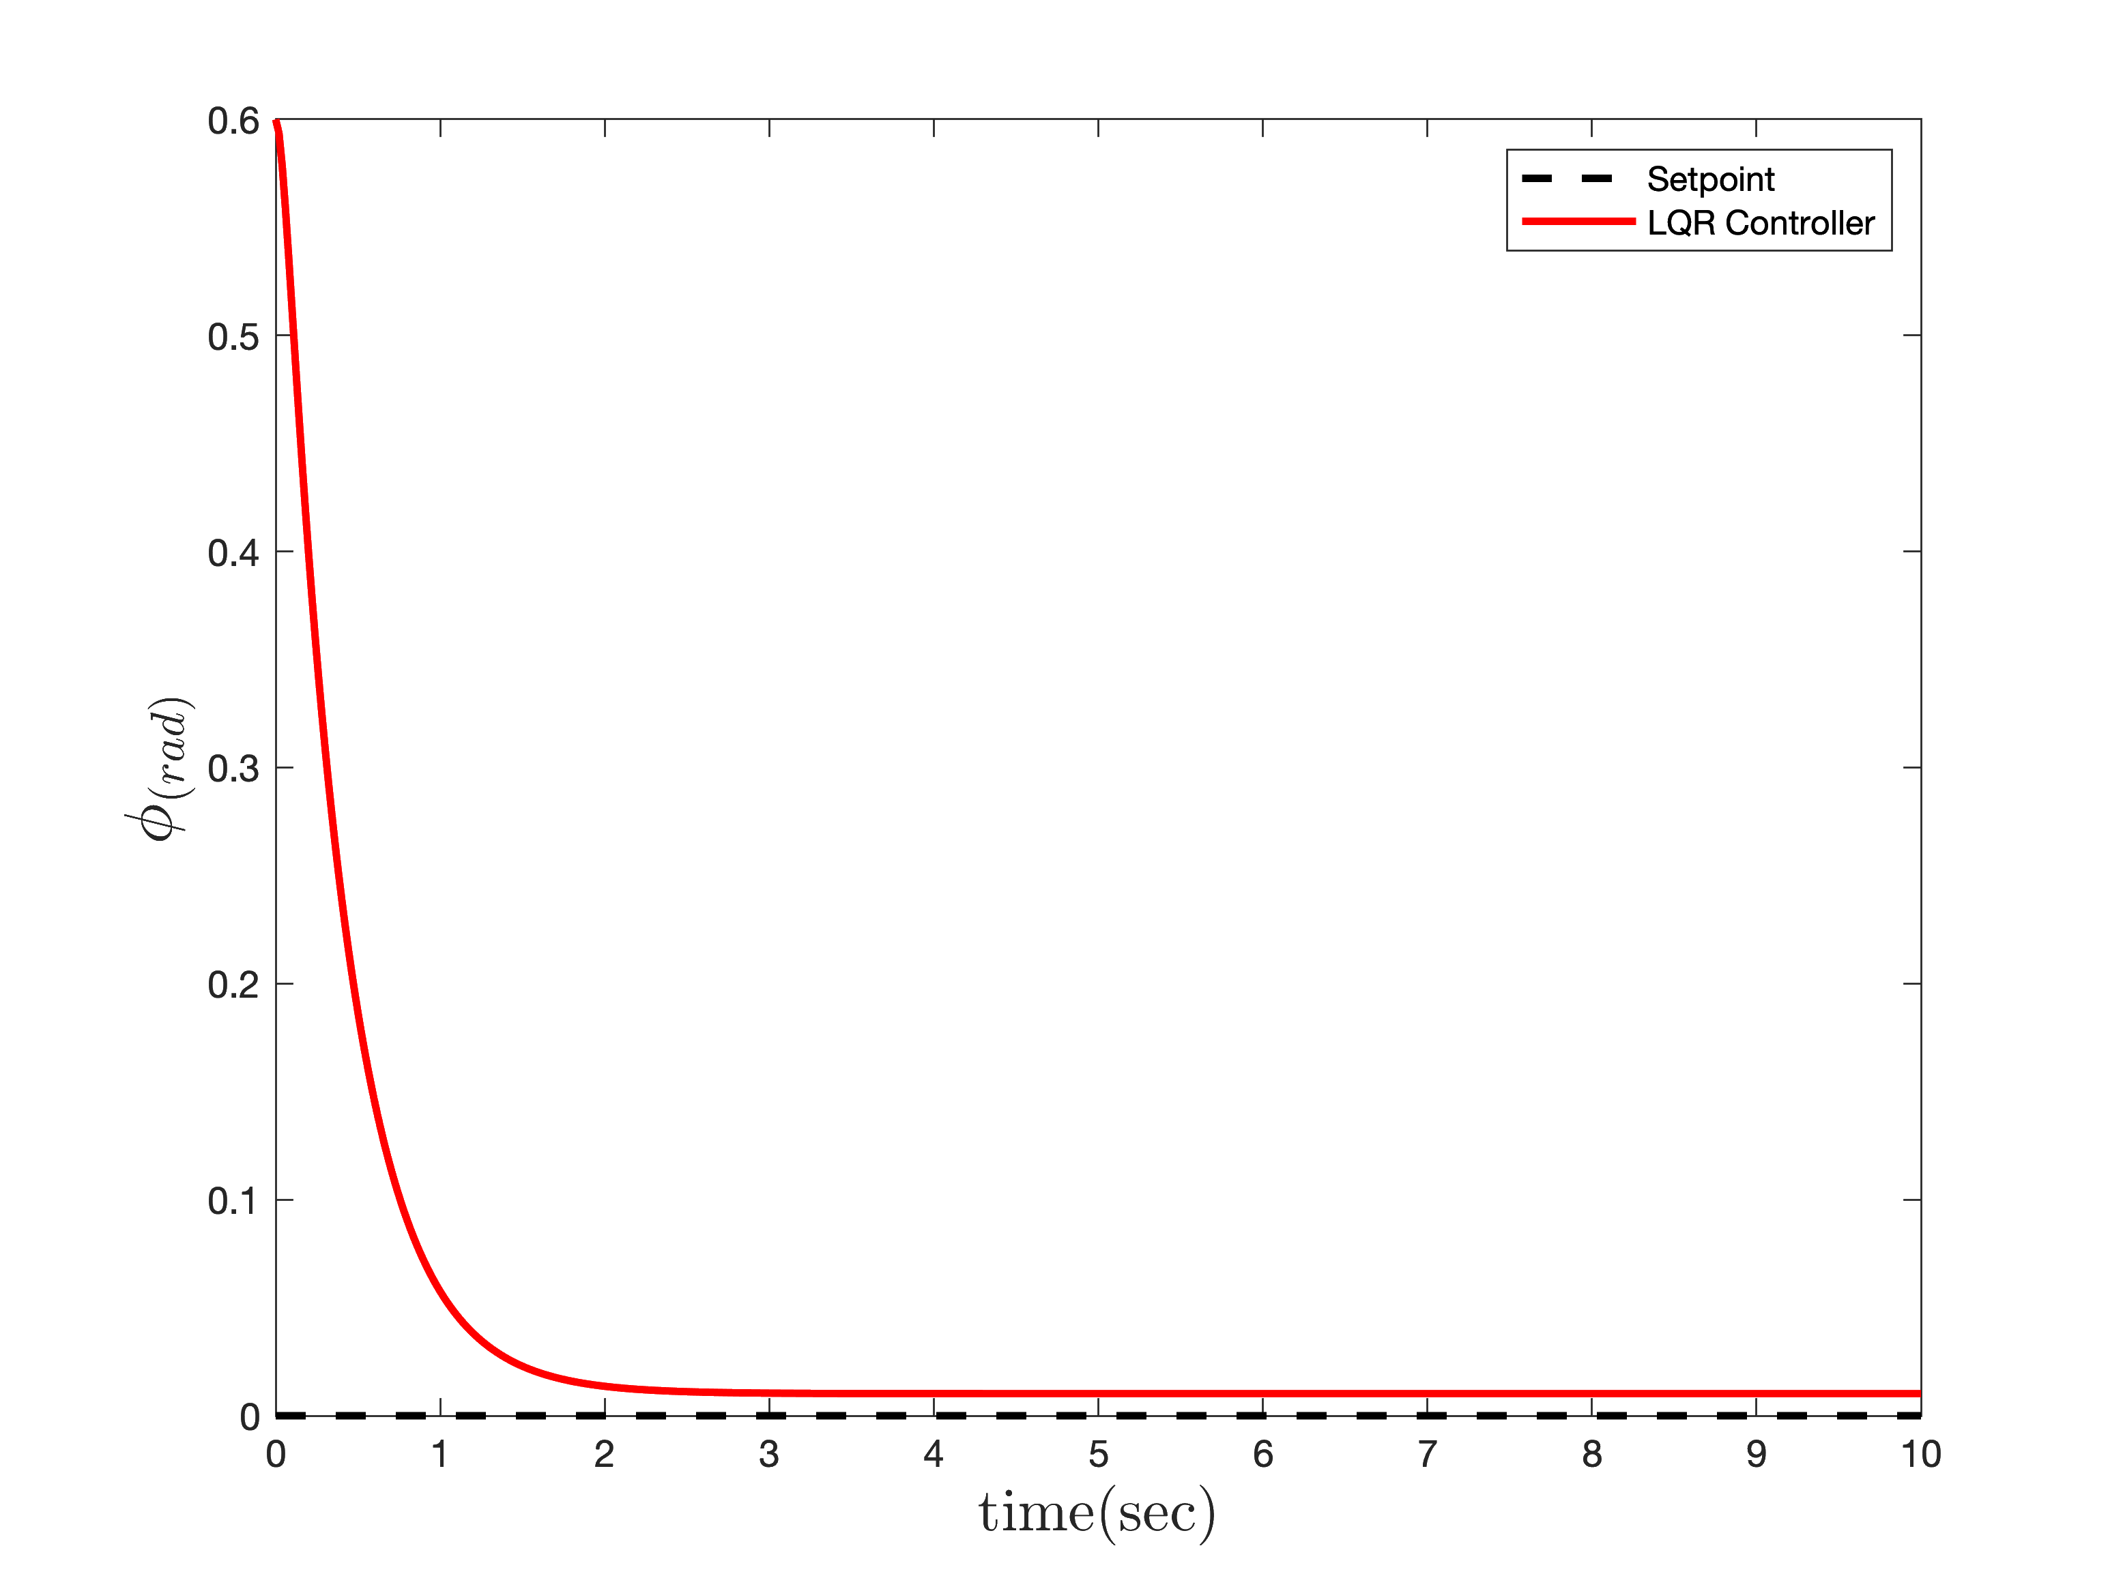
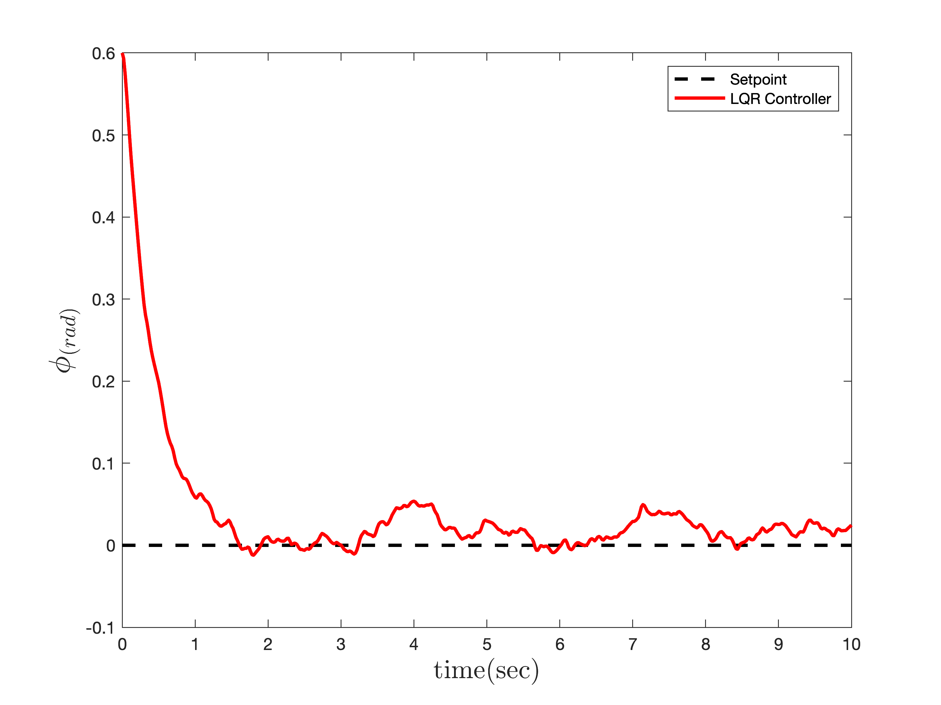
Controller Design
LQR Controller for Roll
Without noise
With noise

Slide 21
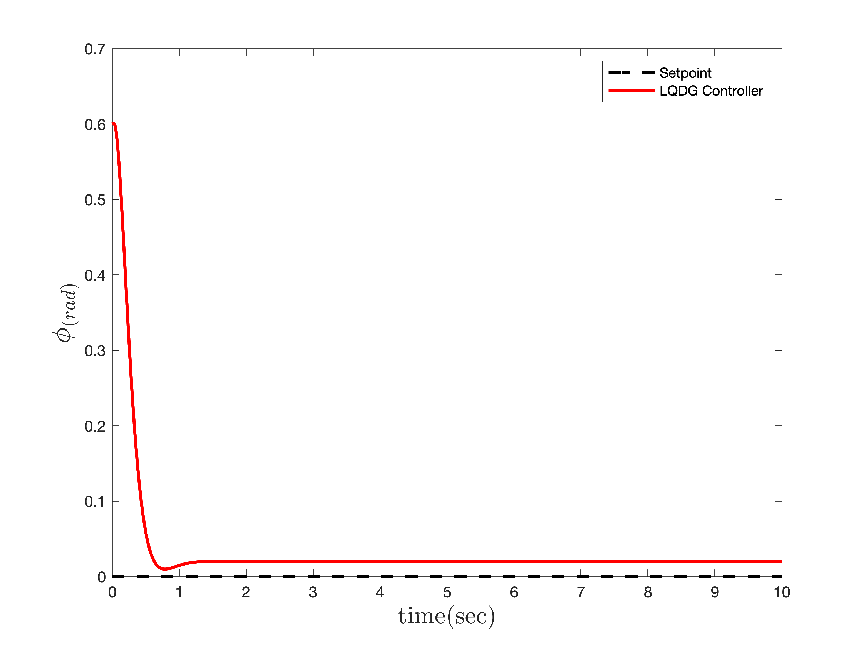
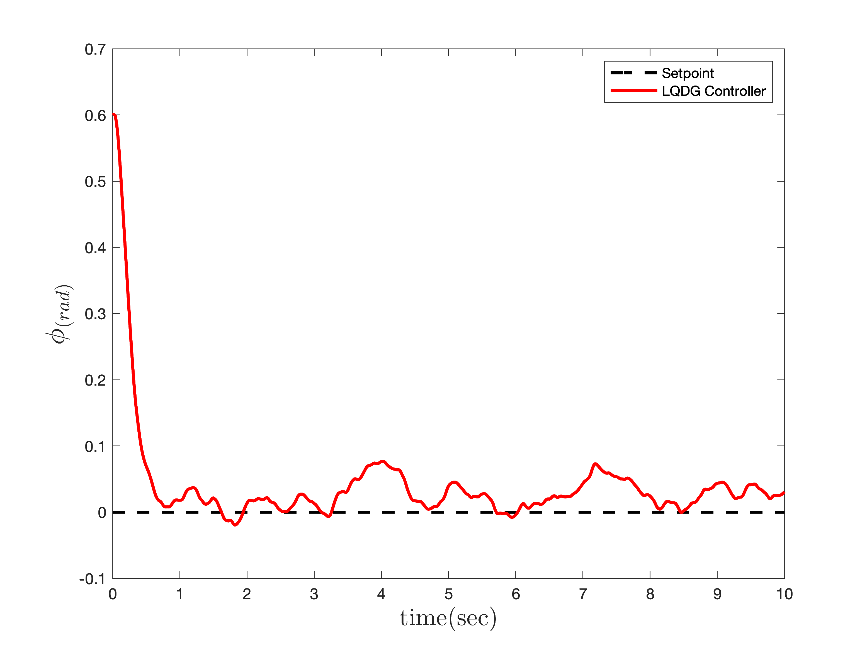
Controller Design
LQDG Controller Roll
Without noise
With noise

Slide 22
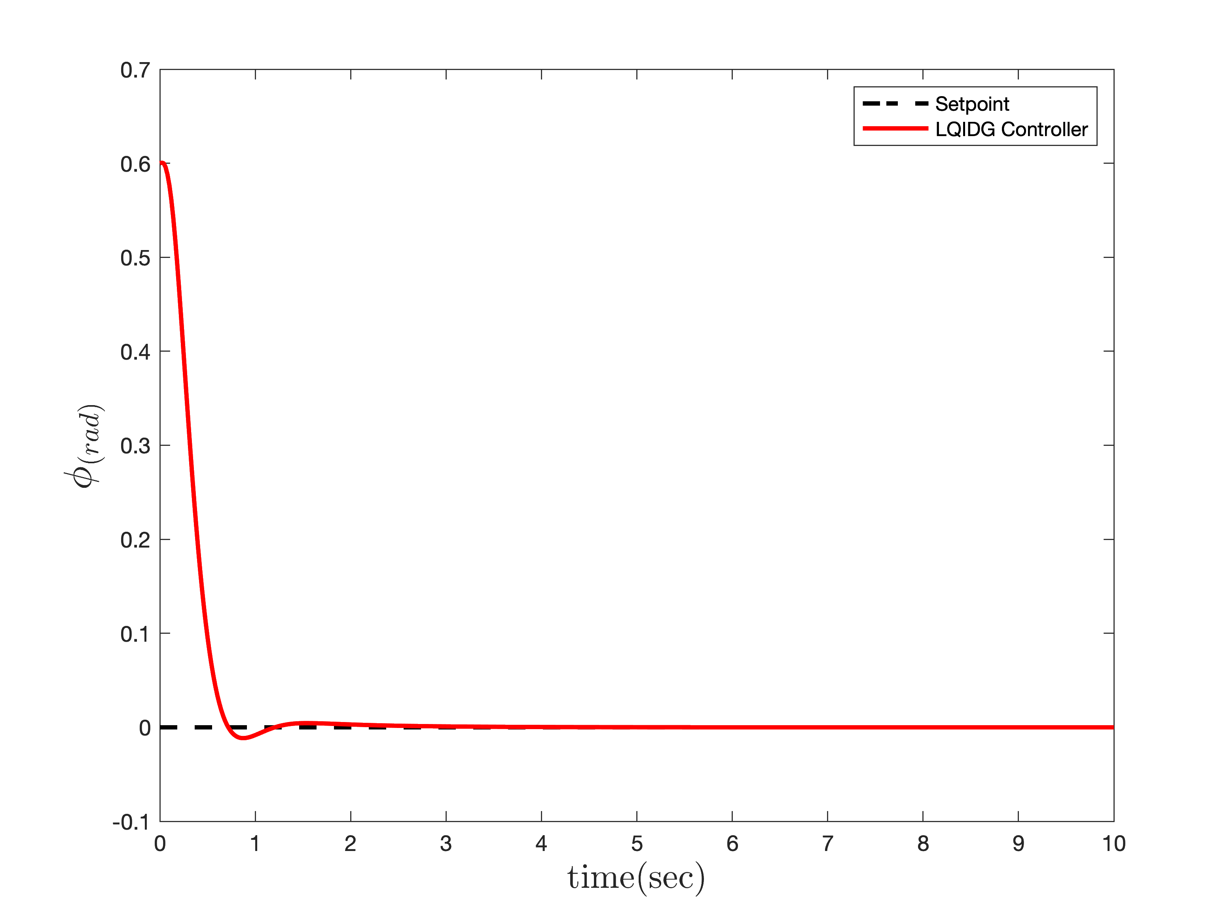
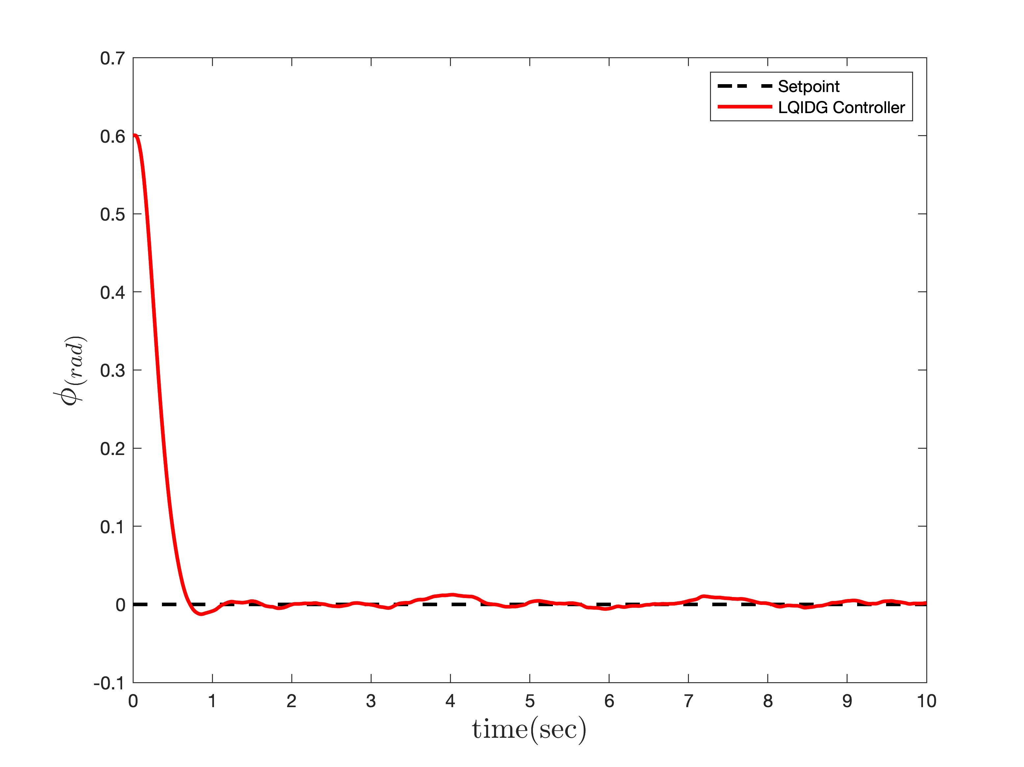
Controller Design
LQIDG Controller for Roll
Without noise
With noise

Slide 23
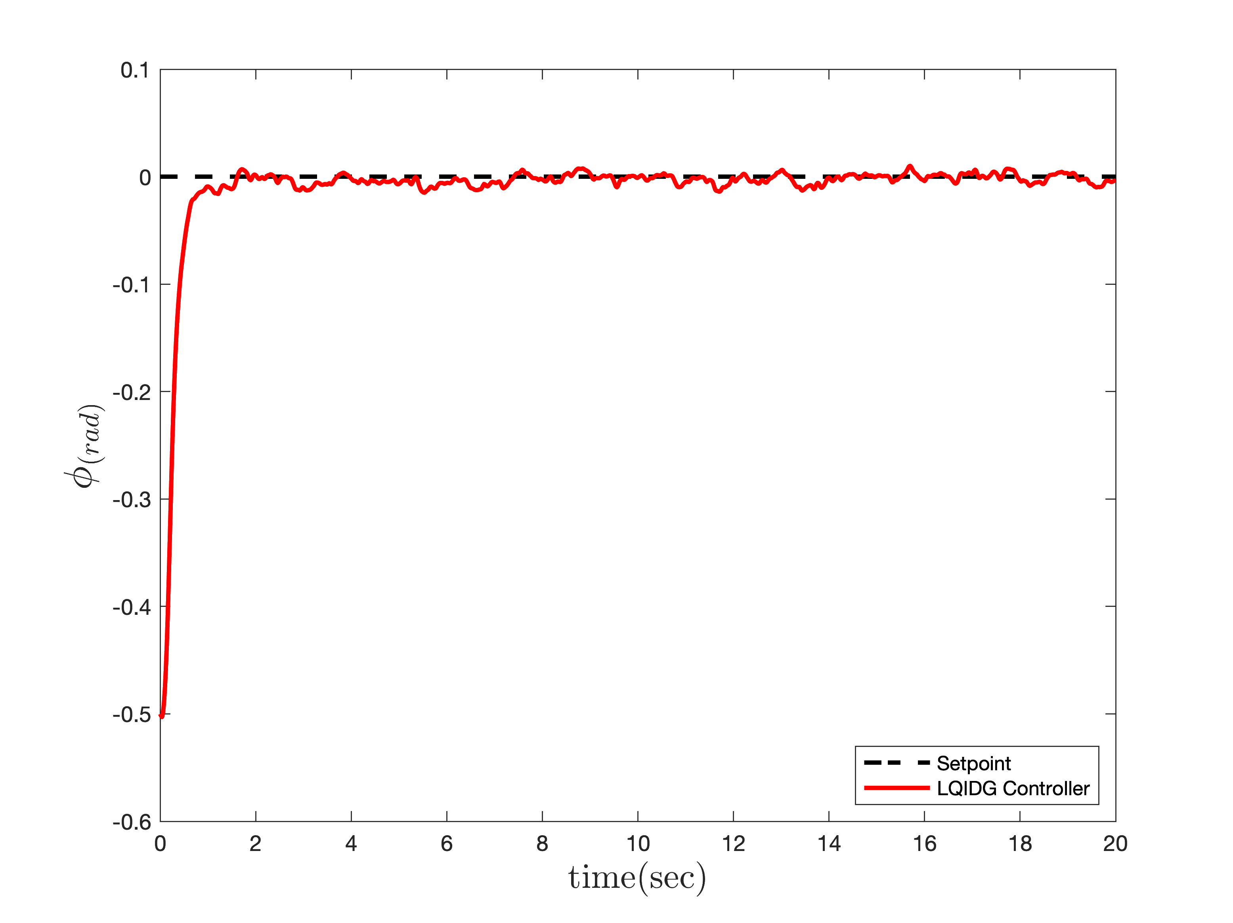
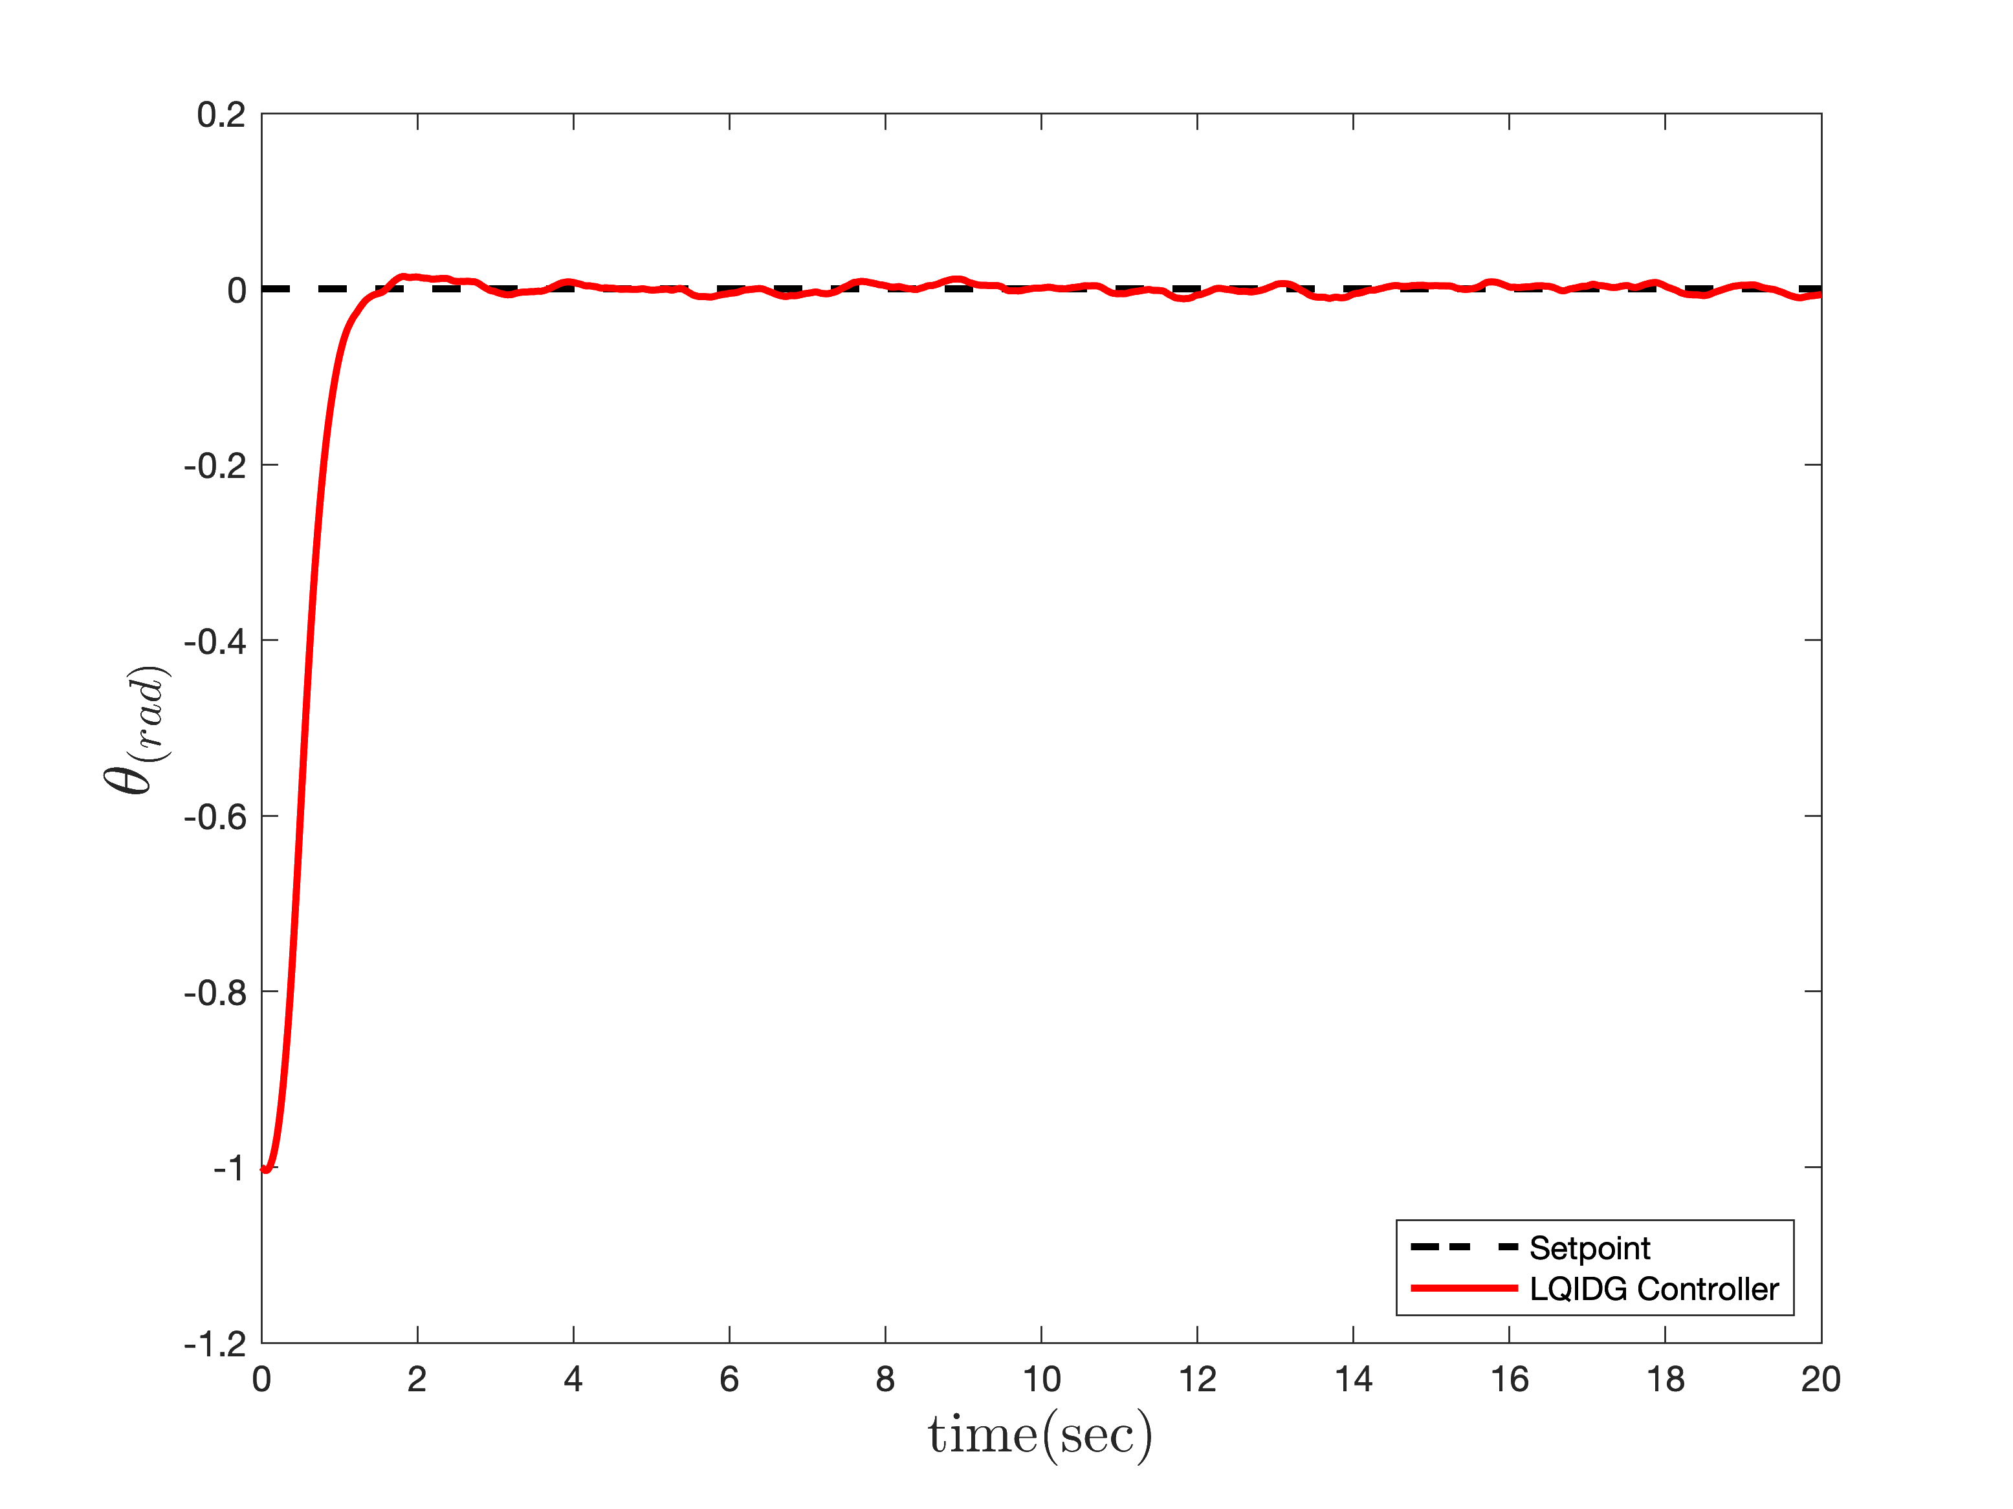
Controller Design
LQIDG Controller
Roll-Pitch with noise

Slide 24
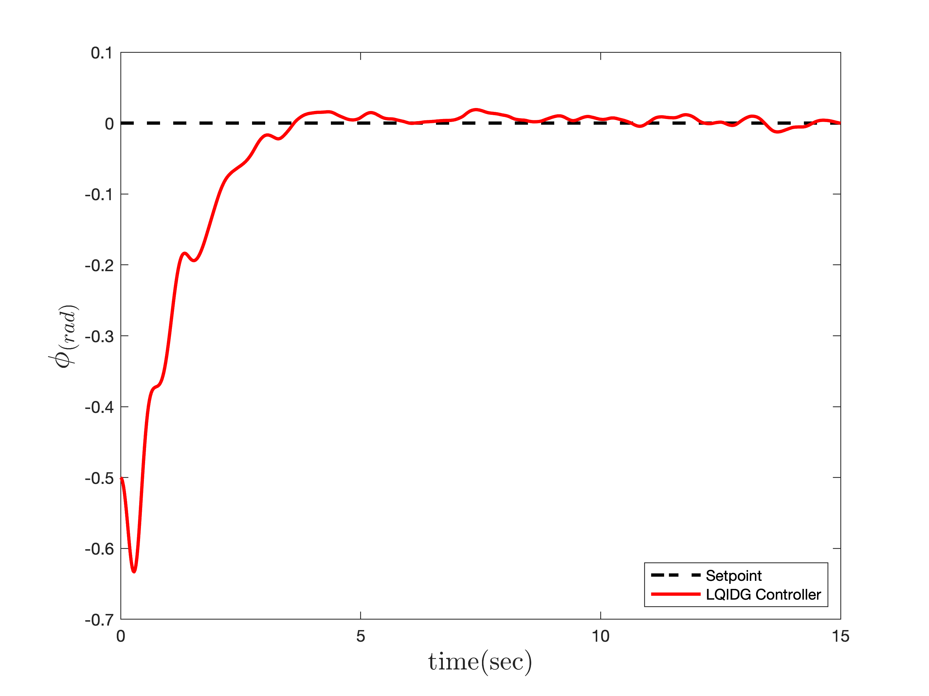
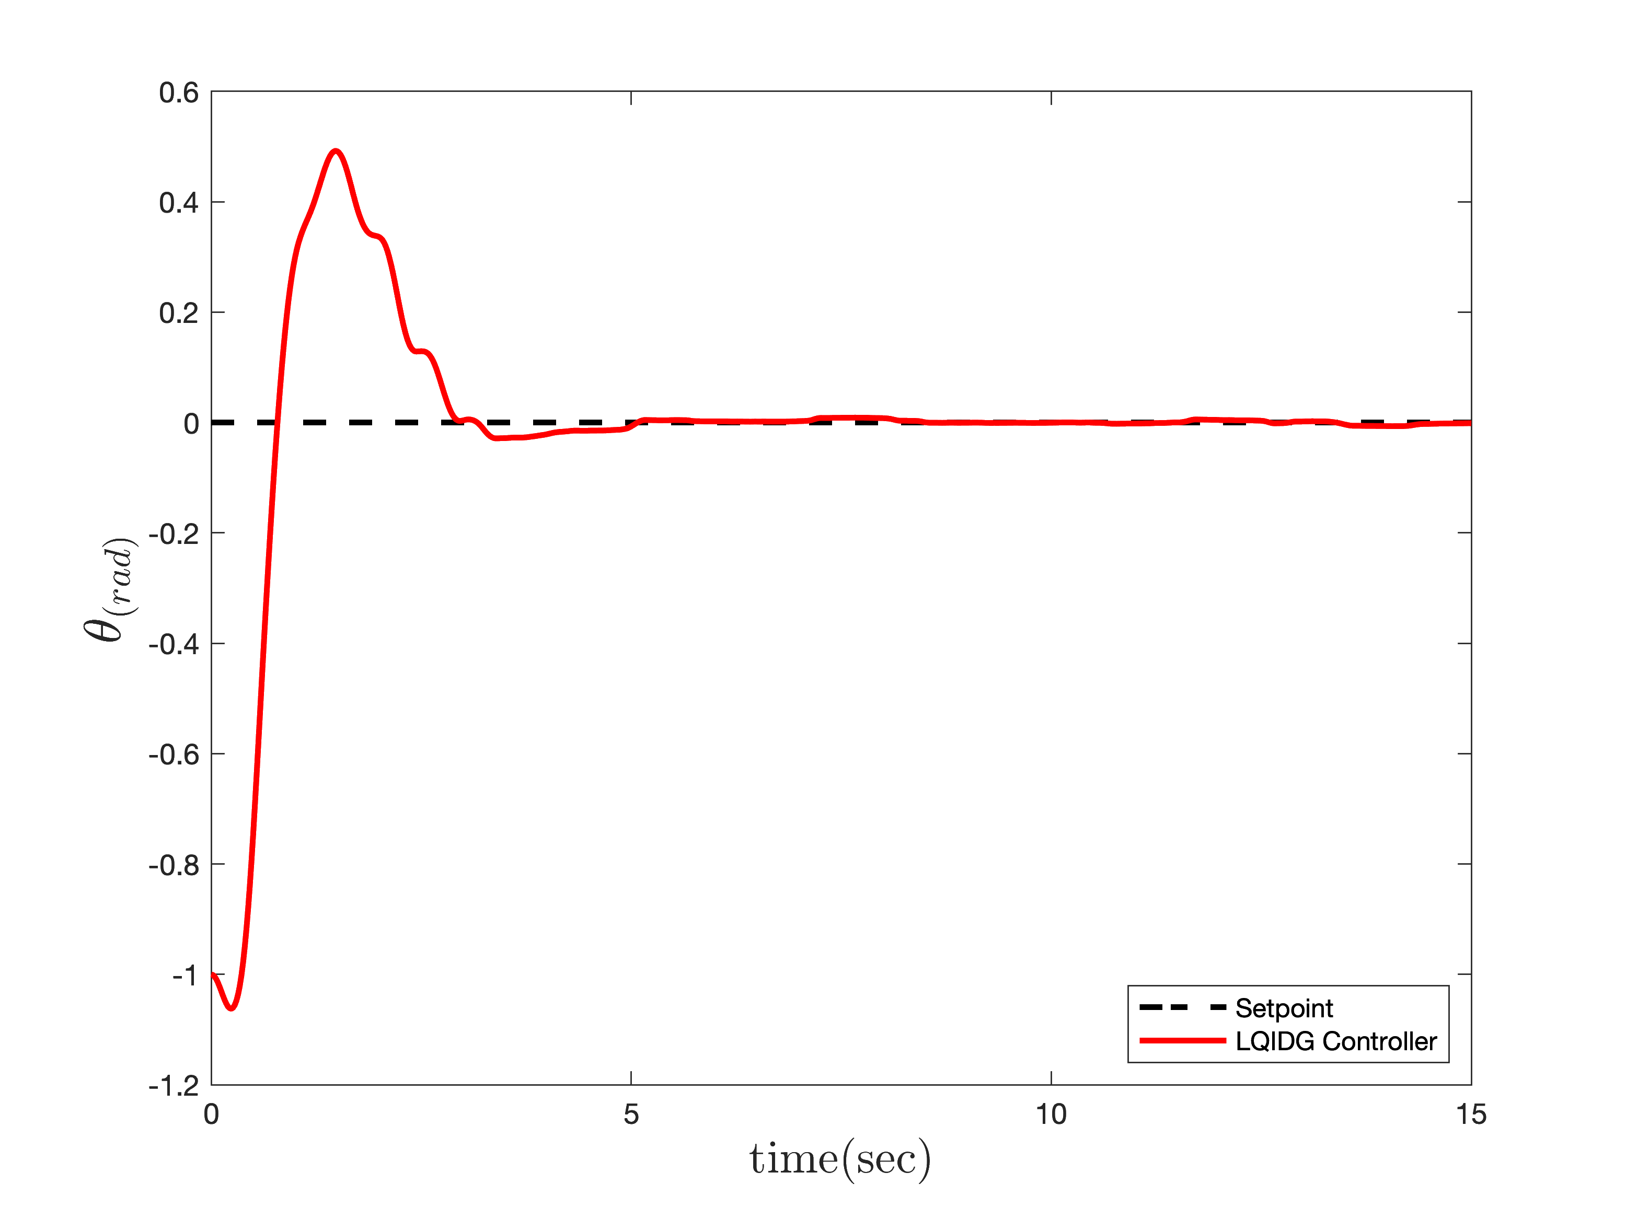
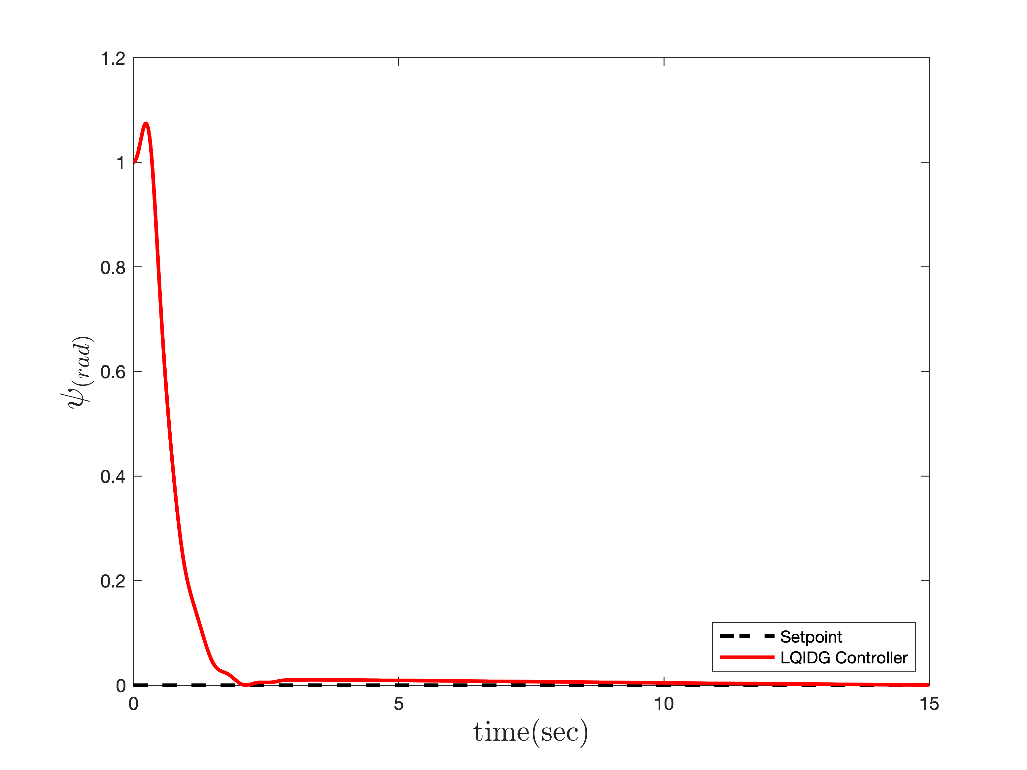
Controller Design
LQIDG Controller
3 Degree Of Freedom with noise

Slide 25
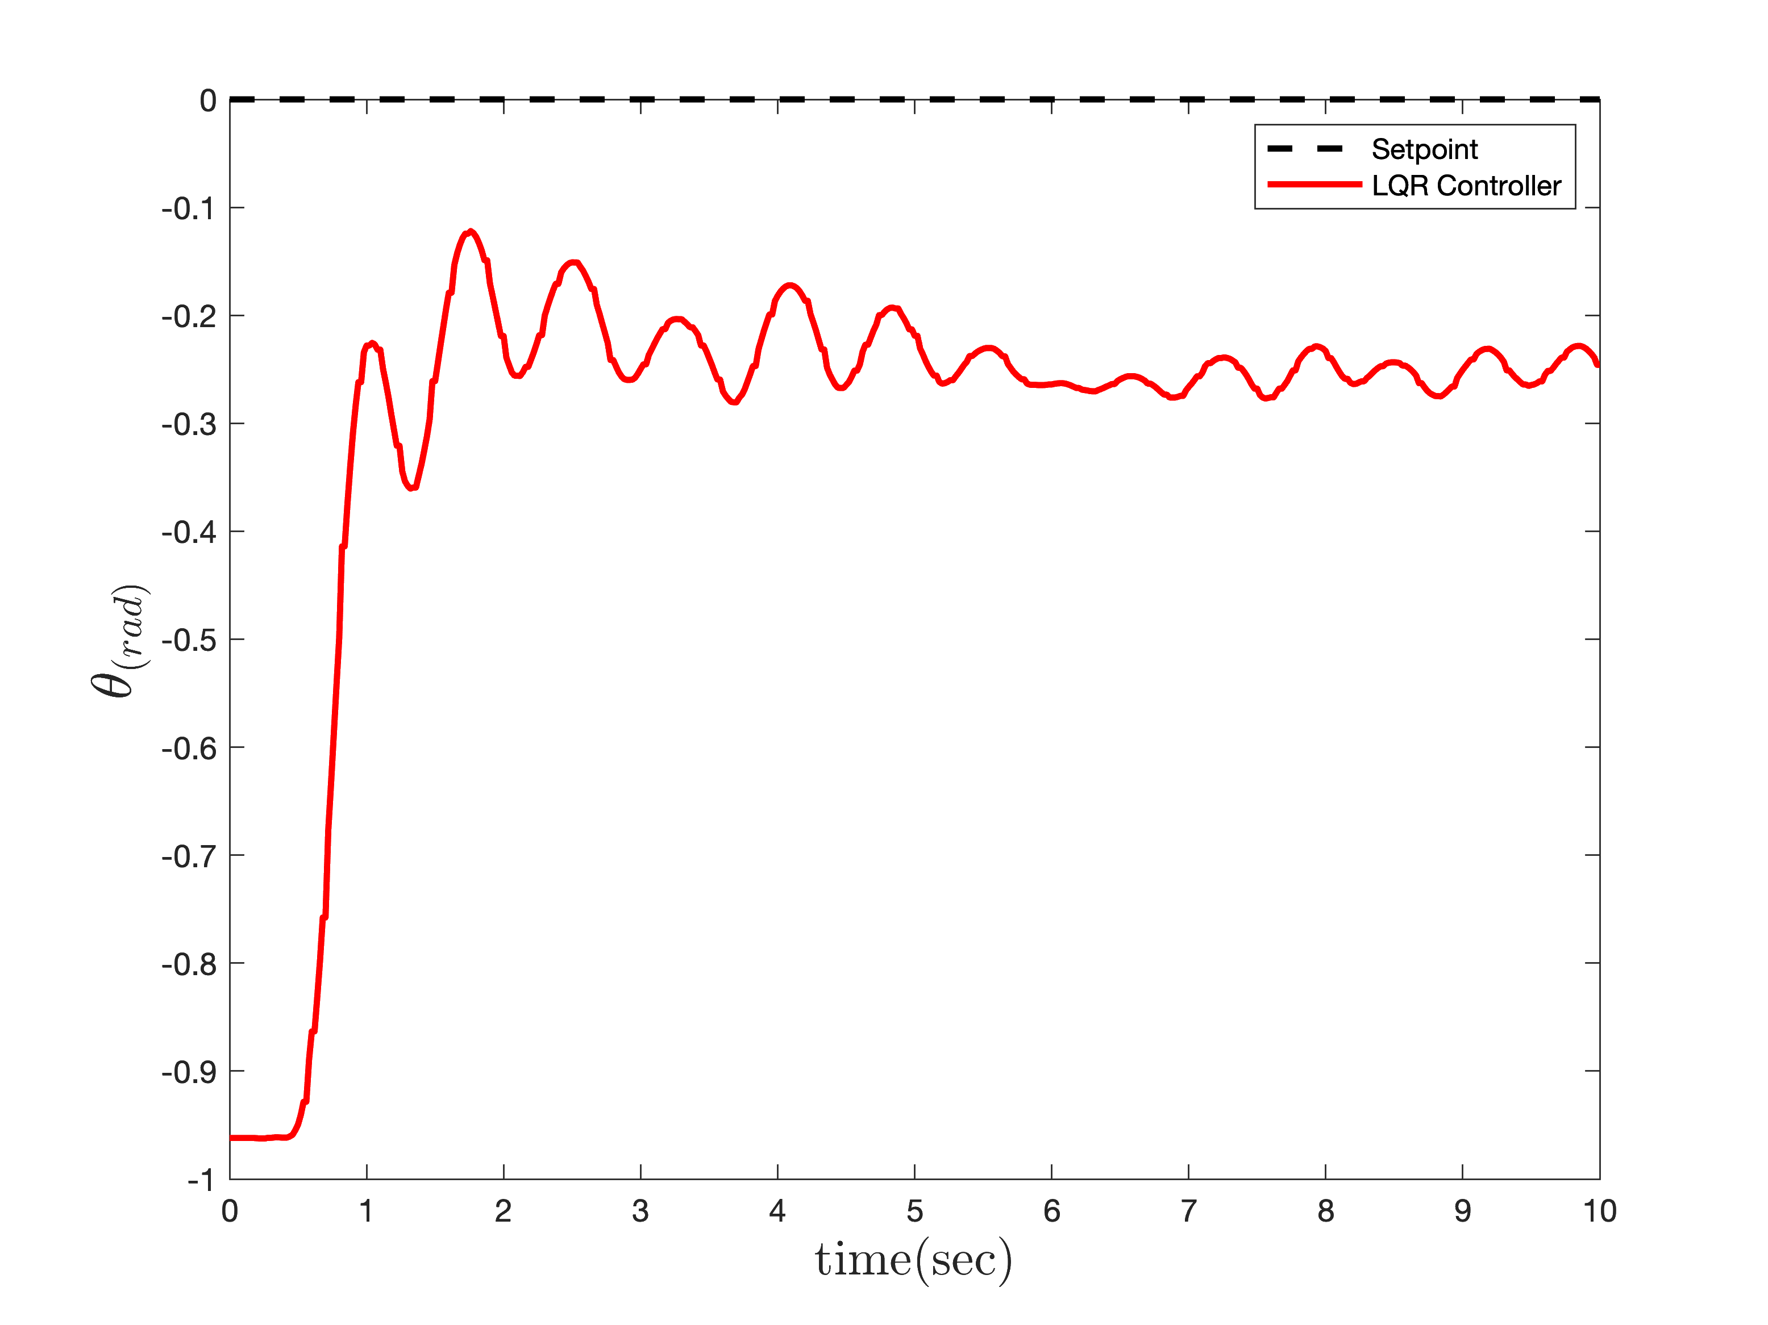
Implementation
LQR Controller
Pitch
Simulating and implementing have the same weighting matrix.

Slide 26
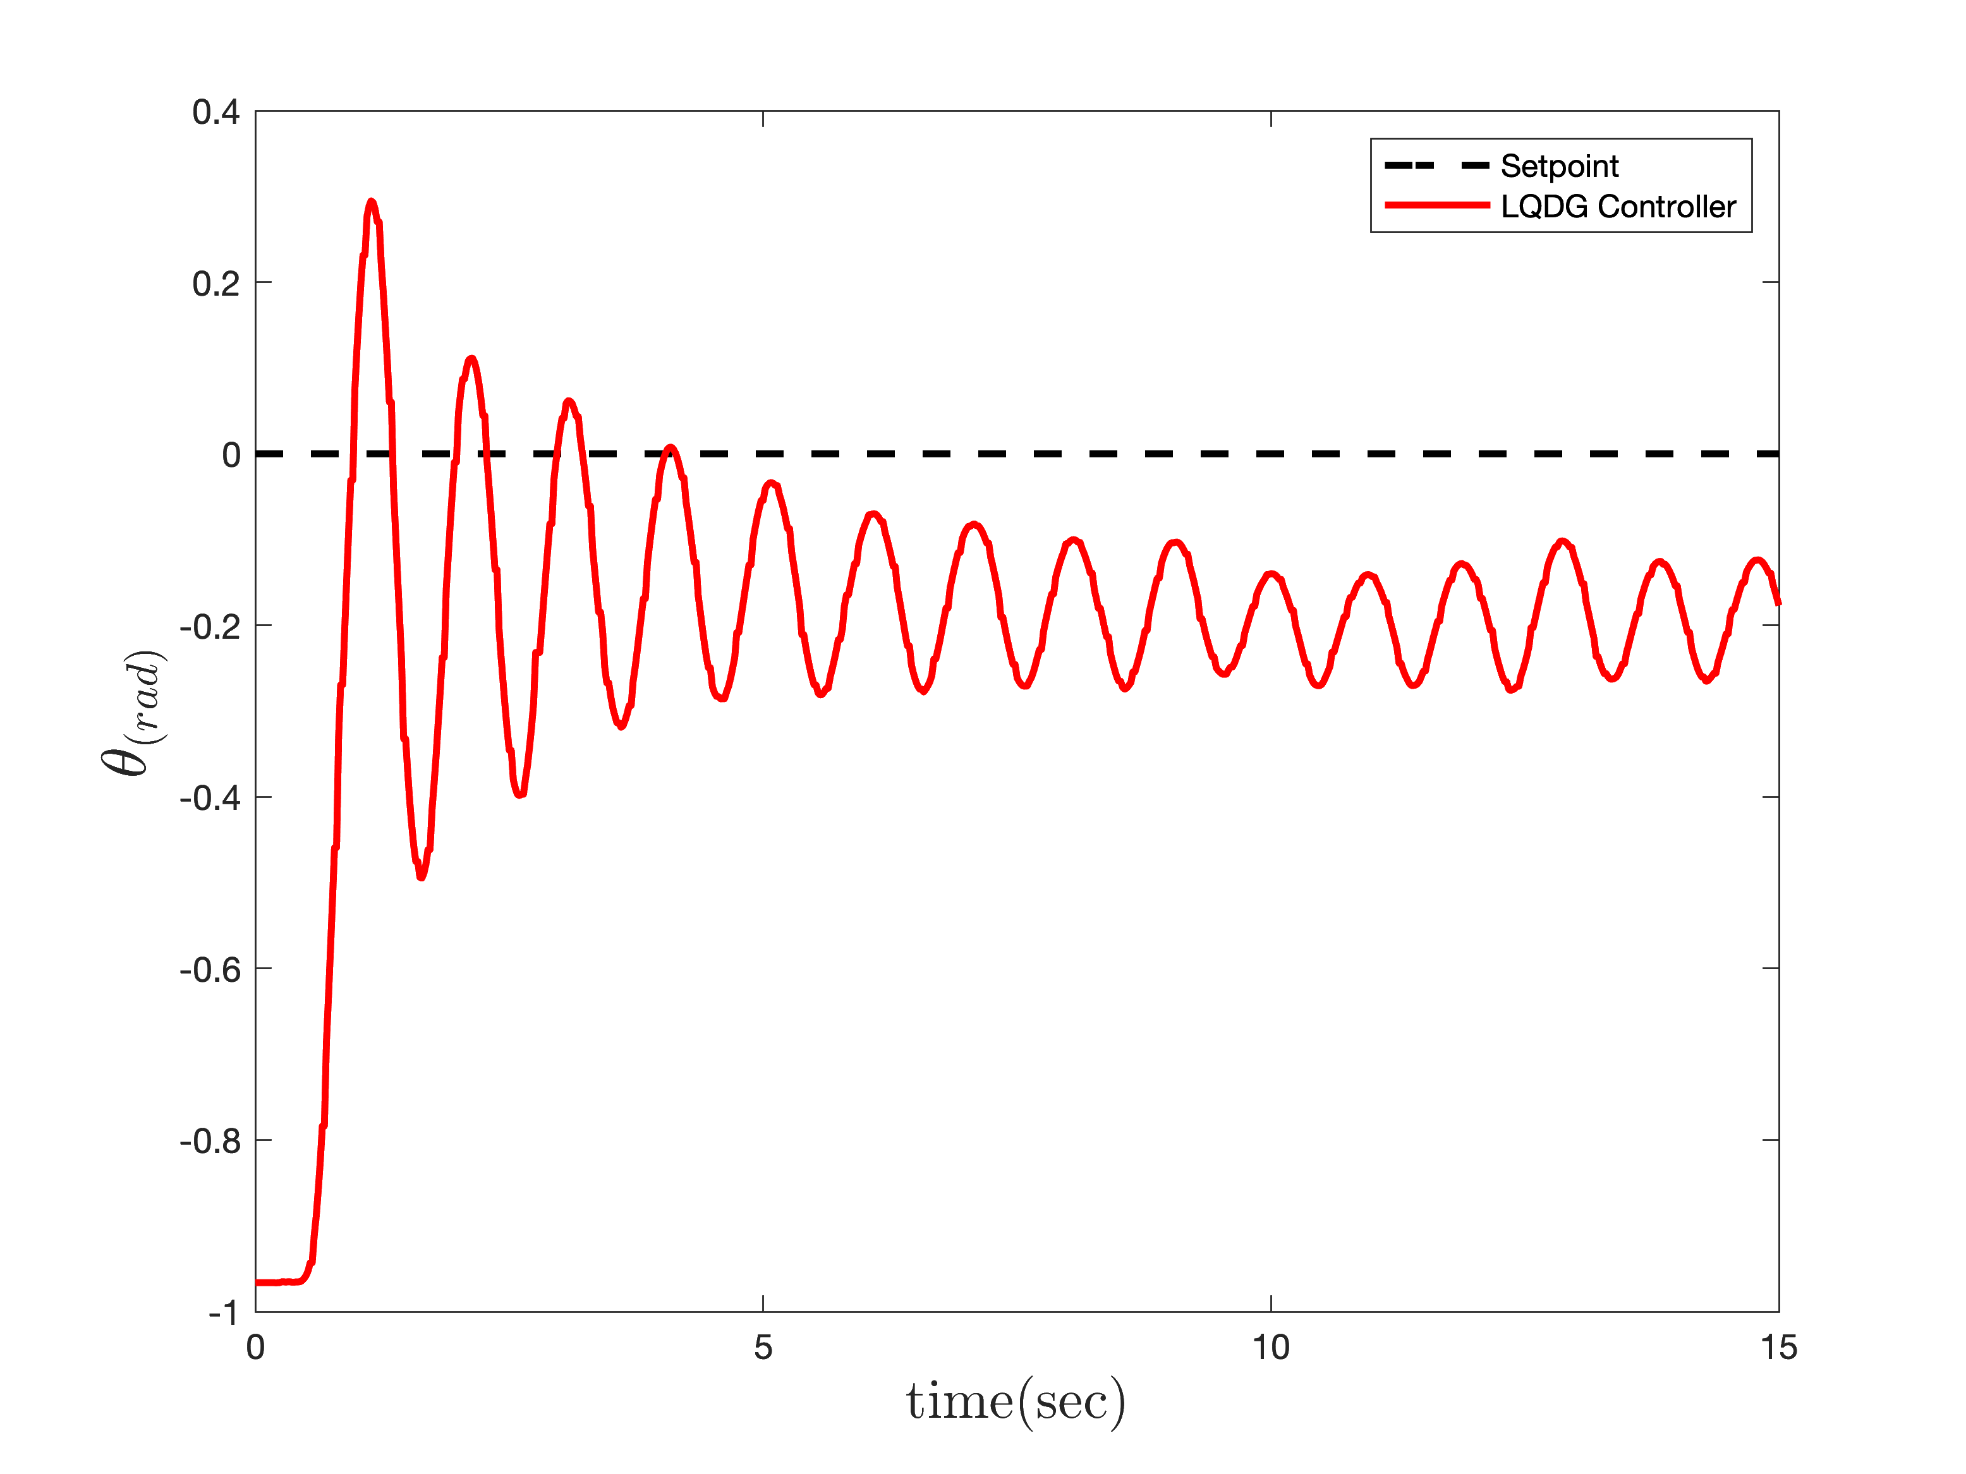
Implementation
LQDG Controller
Pitch

Slide 27
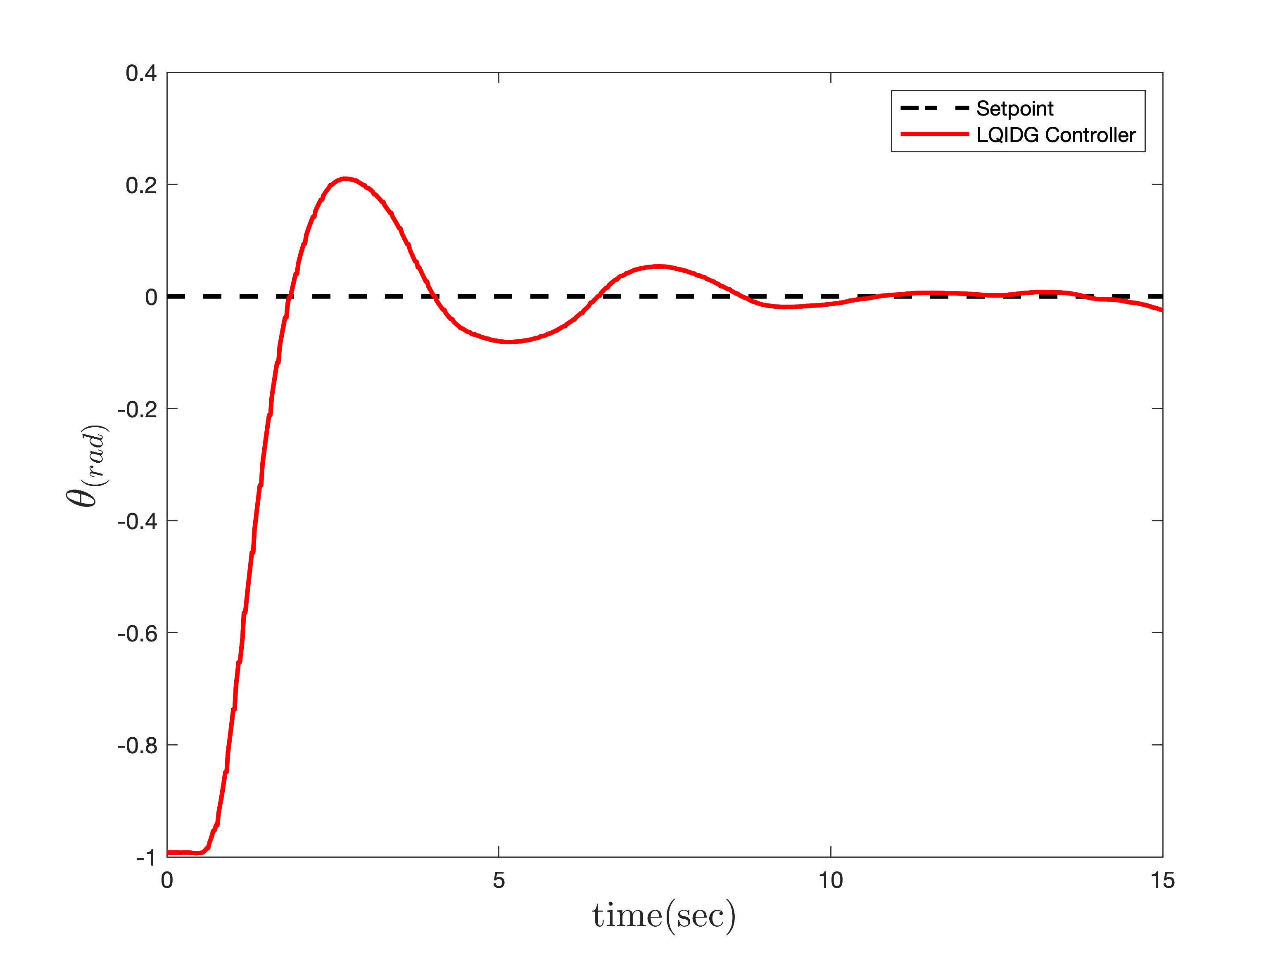
Implementation
LQIDG Controller
Pitch

Slide 28
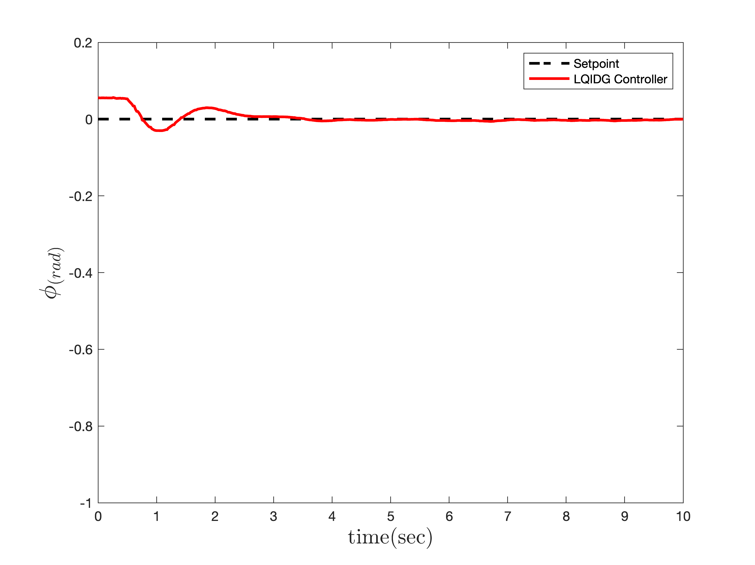
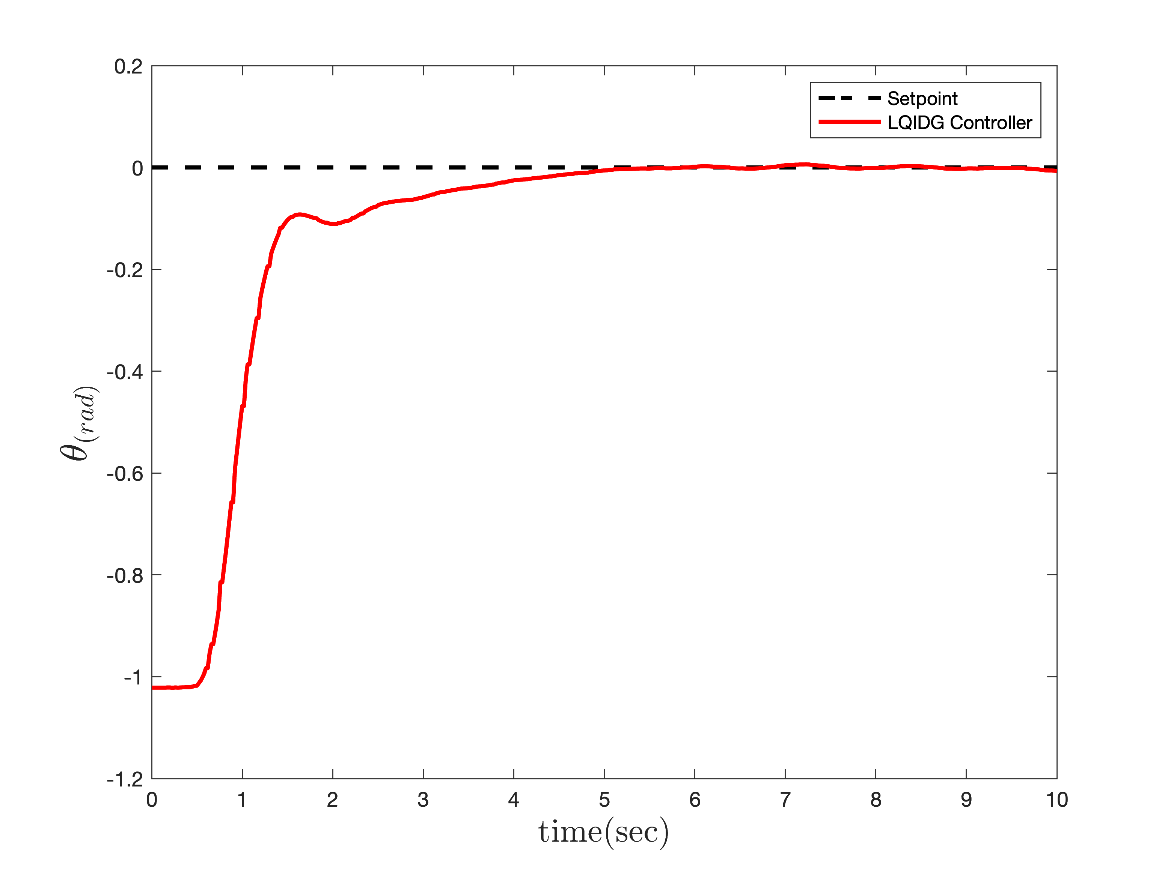
Implementation
LQIDG Controller
Roll-Pitch

Slide 29
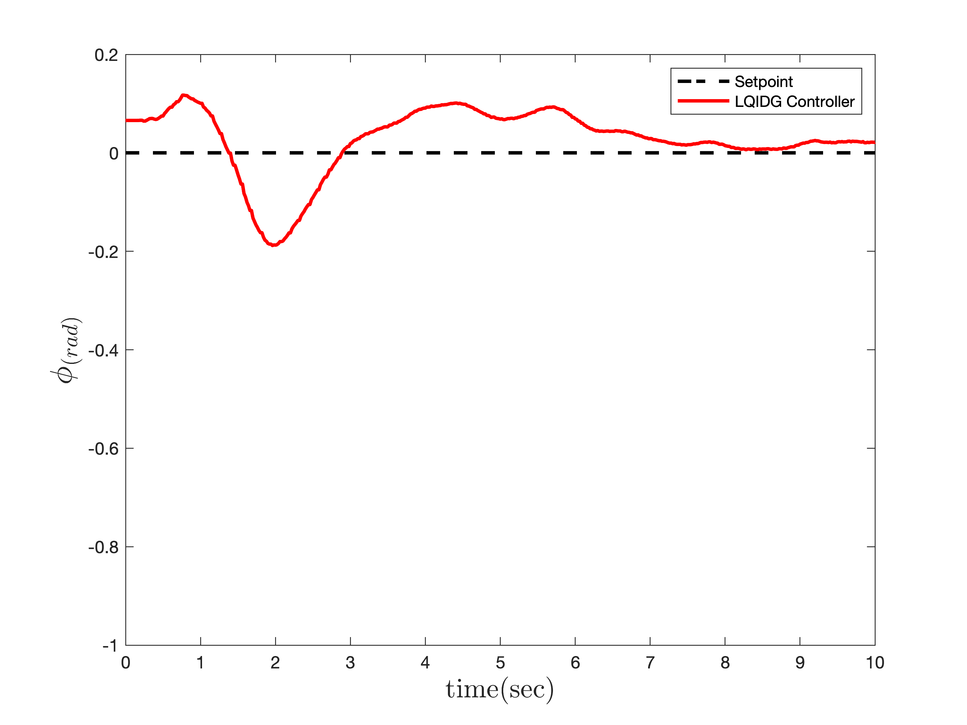
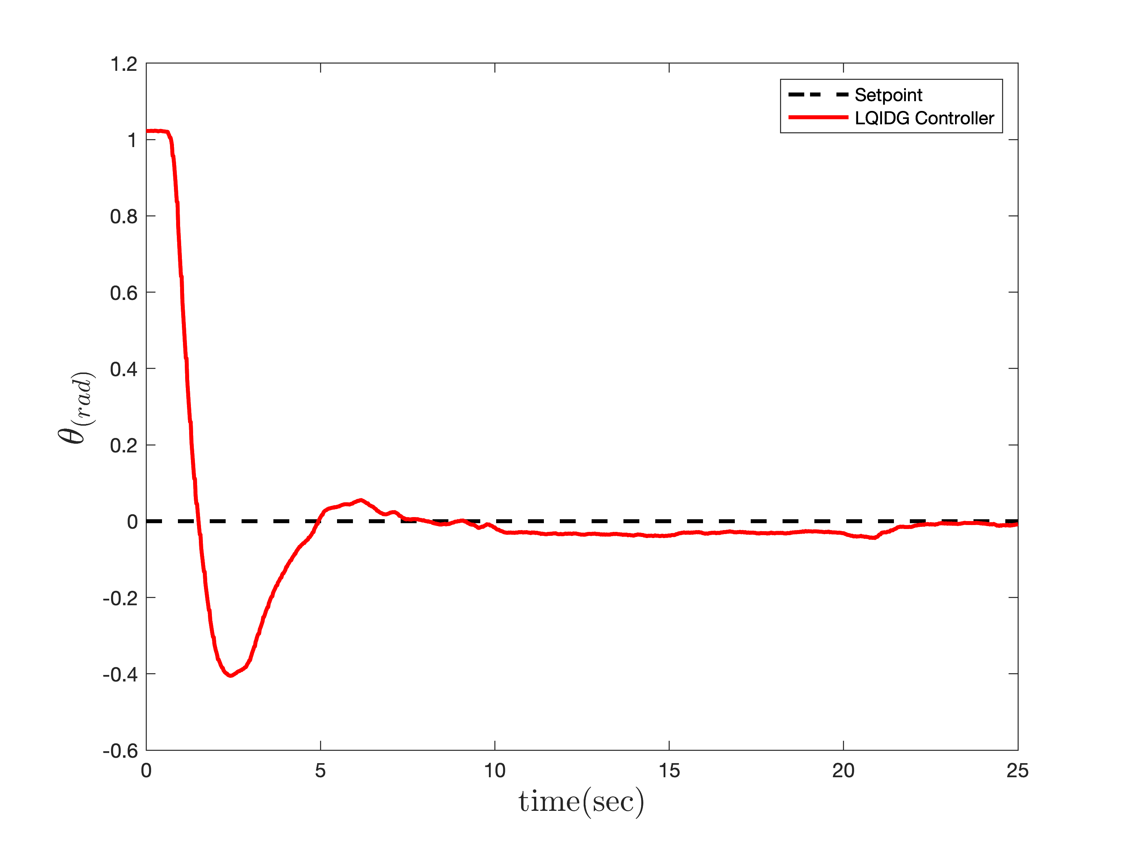
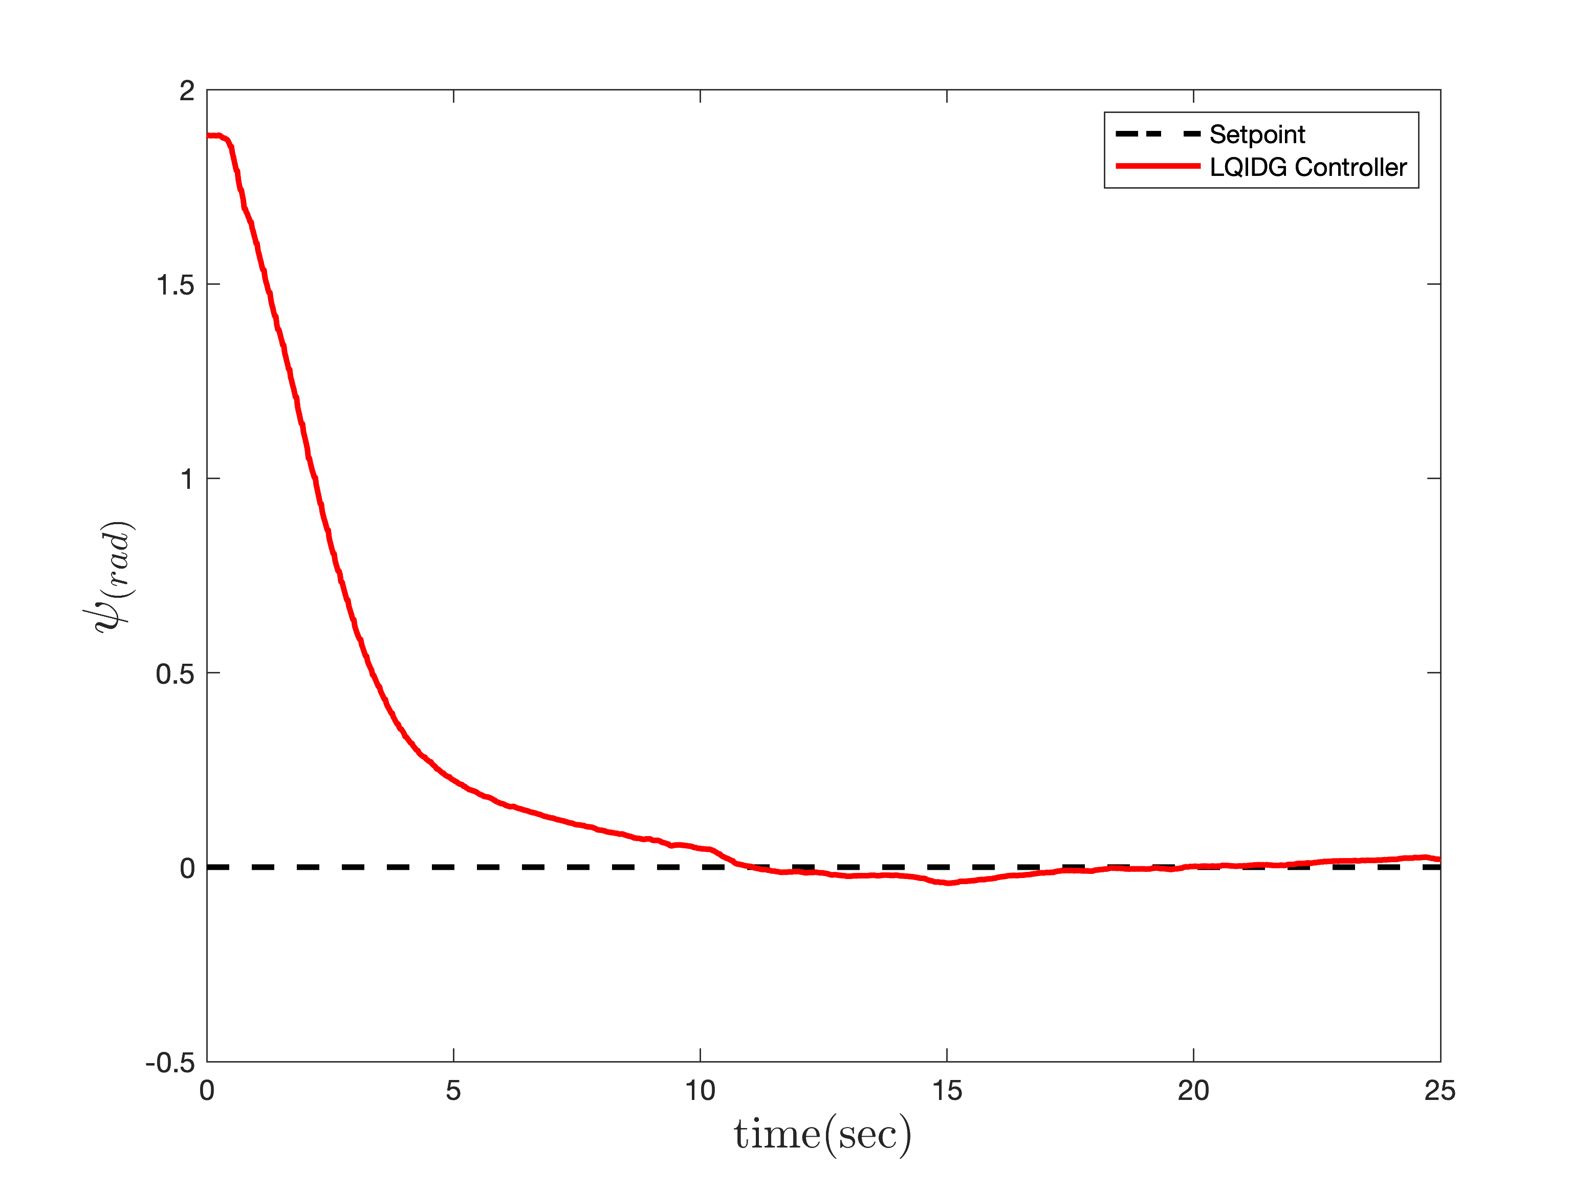
Implementation
LQIDG Controller
3 Degree Of Freedom

Slide 30


Please contact me if you would like access to my thesis on GitHub and GitLab.

Slide 31
Thank You For Your Attention

